Slide 1
Carnegie Hubble Program
A mid-infrared recalibration of the extragalactic distance scale

Slide 2
Carnegie Hubble Program
Wendy Freedman (PI)
Eric Persson, Mark Seibert
Vicky Scowcroft, Andy Monson
Laura Sturch, Jane Rigby

Slide 3
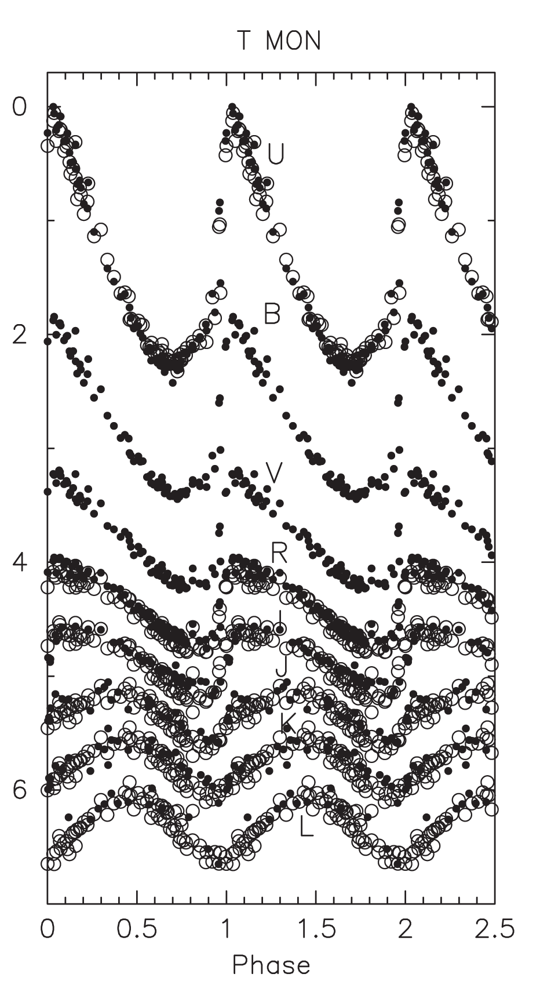
Ceph
Basic Cepheid Light Curves Properties
“Ontology recapitulates Phylogeny” Ernst Haeckel (1838-1919) said that.

Slide 4
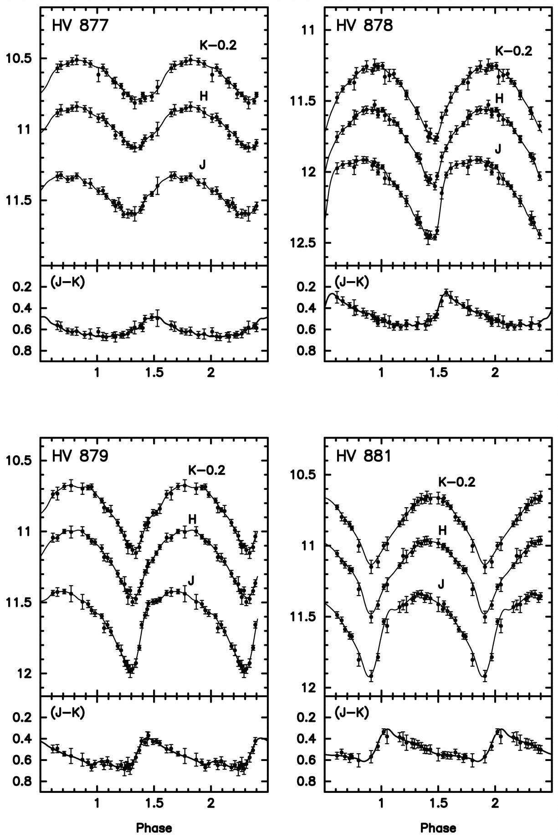
Ceph
Carnegie Hubble Program
(Persson et al. 2004, AJ,128, 2239)

Slide 5
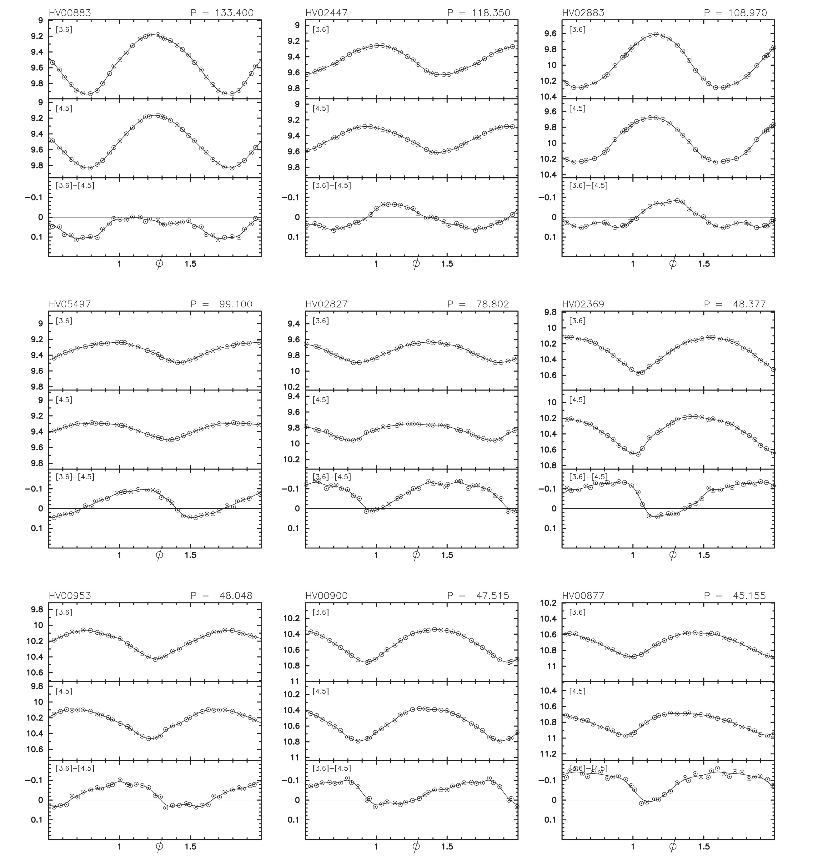
Cephei
LMC Mid-IR/Spitzer Cepheid Light Curves
Scowcroft et al. (2011), ApJ, 743,76

Slide 6
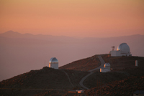
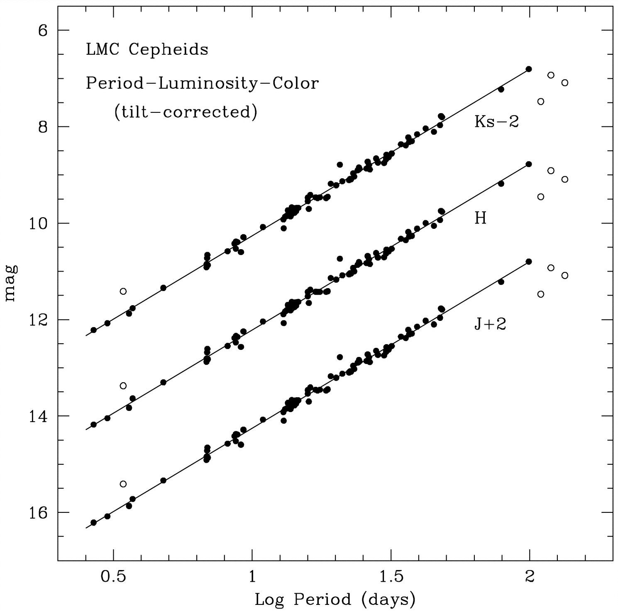
Cepheid Va
Carnegie Hubble Program
(Persson et al. 2004, AJ,128, 2239)

Slide 8
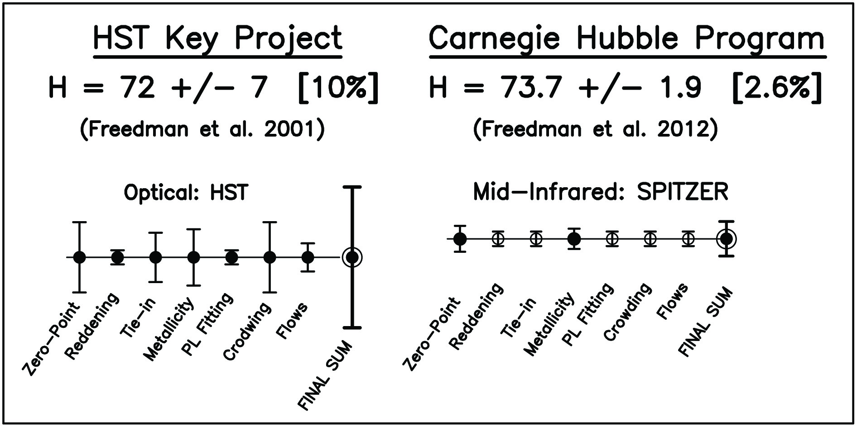
Cepheid Variables
Carnegie Hubble Program
(Freedman et al. 2012)

Slide 9
H = 74 km/s/Mpc ➔ Four Neutrinos

Slide 10
Dominance of AGB Stars in Mid-IR

Slide 11
IC 1613 at 3.6 microns

Slide 12
Carbon stars dominating NGC 4258

