Slide 1
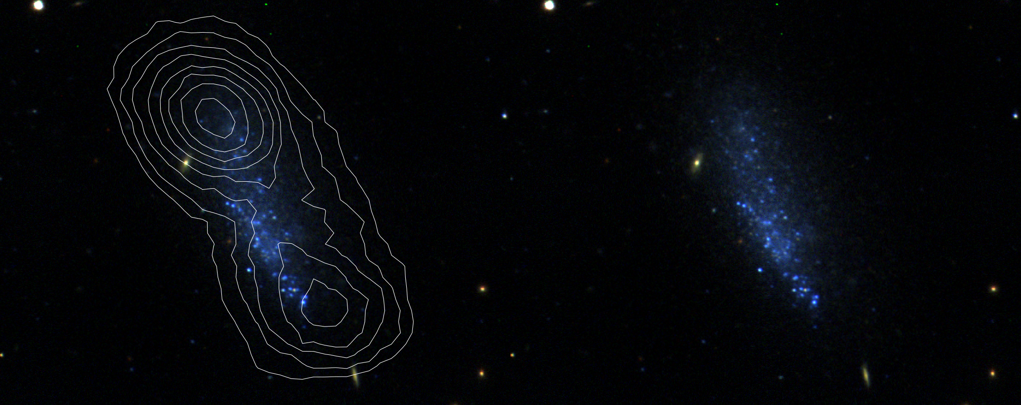
SHIELD: The Survey of HI in Extremely Low-mass Dwarfs
John M. Cannon
Macalester College
TF35 – Green Bank, WV
April 1, 2012

Slide 2
SHIELD: Team Members
PI: John M. Cannon (Macalester College)
Macalester College (UAT stipends): Clara Thomann, Ian Cave, Melissa Marshall
Cornell: Betsey Adams, Riccardo Giovanelli, Martha Haynes, Shan Huang
Indiana: Steven Janowiecki, Angela Parker, John J. Salzer
Minnesota: Kristy McQuinn, Evan D. Skillman
MPE: Amélie Saintonge
NRAO: Jürgen Ott
Western Australia/ICRAR: Ed Elson
Macalester College: John Allan, Eric Engstrom, Grace Erny, Palmer Fliss, AnnaLeigh Smith

Slide 3
On The Importance of Low-mass Galaxies
The λCDM paradigm predicts more low-mass dark matter halos in the local universe than are observed
“Missing satellite problem”
Local low-mass systems are survivors of the structure formation process
Changes in physical parameters and mechanisms are predicted in low-mass galaxies
Decreasing baryon fraction
Different relation between mass surface density and star formation rate than in massive galaxies
Extreme and untested ISM conditions
Opportunities for leaps forward in our understanding of galaxy evolution

Slide 4
Terra Incognita: ALFALFA
Haynes et al. (2011)
ALFALFA now has cataloged >400 galaxies with M_{HI} < 10⁸ M and a few dozen with M_{HI} < 10⁷ M
What is the nature of galaxies with M_{HI} < 10⁷ M?

Slide 5
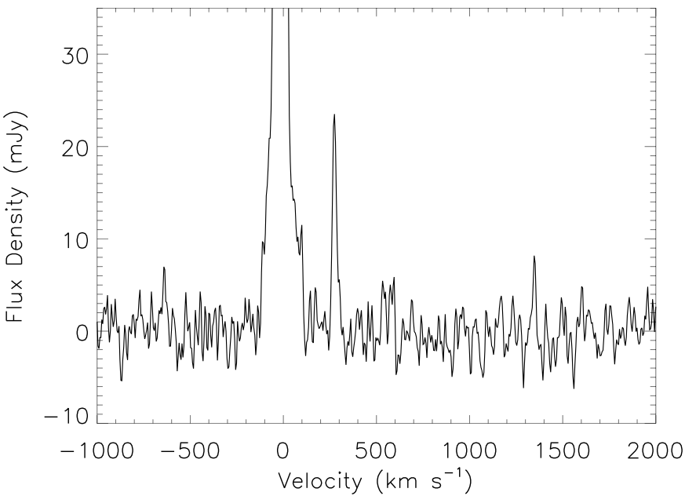
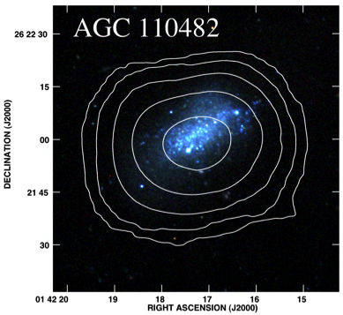
Harvesting ALFALFA: detectable stellar populations
What is the nature of galaxies with HI masses of 10⁷ M and below?

Slide 6
SHIELD: Overview
The Survey of HI in Extremely Low-mass Dwarfs
12 systems selected from > 20,000 ALFALFA sources
M_{HI} < 10⁷ M
W₅₀ < 65 km s⁻¹
Model distances < 8 Mpc
Detectable stellar populations
15 hours per source with the EVLA (9/4/2 in B/C/D)
0.86 km s⁻¹ ch⁻¹
5σ detection (per channel) of 10¹⁹ cm⁻² (2.3x10²⁰ cm⁻² ) columns at 40′′ (6′′) resolution

Slide 7
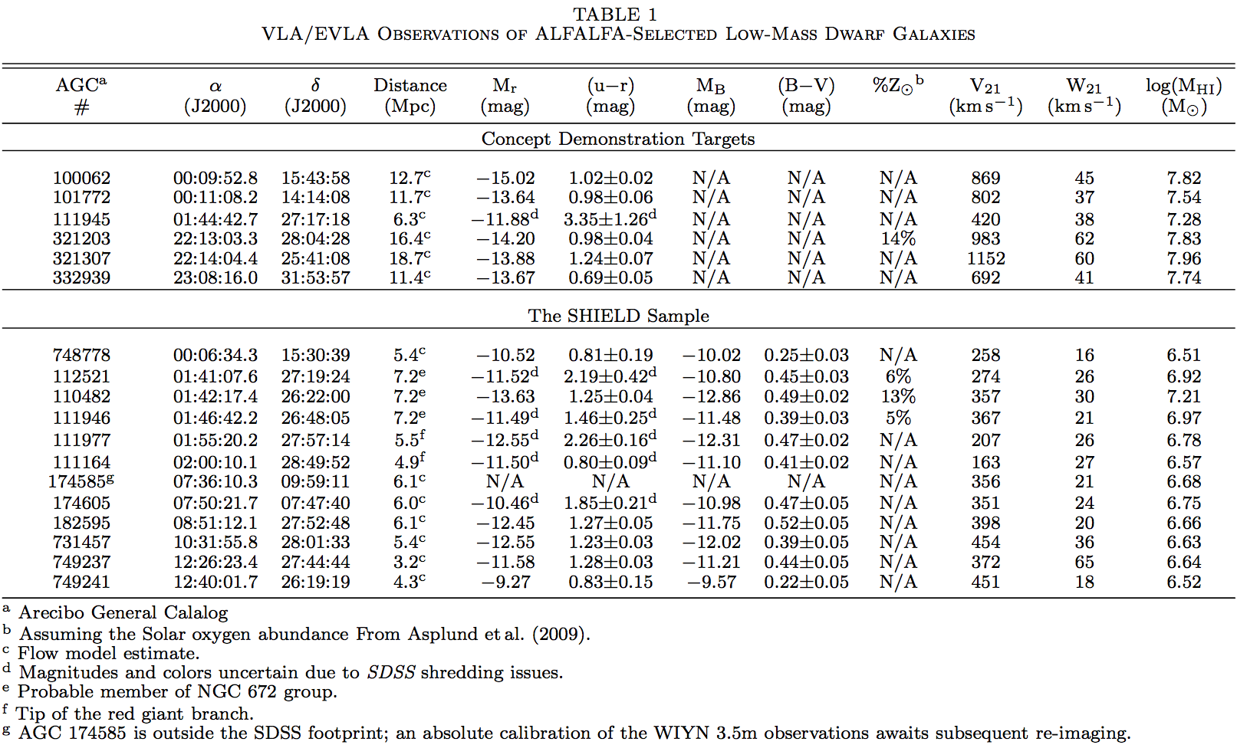
SHIELD: Sample Overview
Median (estimated) HI mass = 4.7x10⁶ M
Distances uncertain: critical need for HST

Slide 8
SHIELD: Science Drivers
What properties change between mini-halos, very low-mass dwarfs, and more massive systems?
What fraction of the mass in these low-mass dwarfs is baryonic?
Is the character of the SF process different in very low-mass galaxies?
Notes:
Identify correlations between fundamental galaxy parameters (e.g., HI line width, stellar mass, SF rate, etc.) by undertaking a comparative study of these properties in objects that span some three orders of magnitude in dynamical mass, from ∼10⁶ –10⁹ M⊙ (i.e., covering the mini-halo to dwarf galaxy transition region)
ISM kinematics on spatial scales of order 200 pc (assuming a 6′′ beam and a maximum distance of ∼8 Mpc)
Extract rotation curves in the inner regions and infer the dark-to-baryonic fraction throughout the disks
Explore the metal-poor, molecular ISM for the first time with ALMA
Galaxies have retained significant HI mass reservoirs over a Hubble time; apparently evolving in relative quiescence and are exceedingly inefficient at converting their interstellar gas into stars
SF law appears to deviate from the “canonical” Schmidt-Kennicutt prescription used in more massive systems (Kennicutt 1998)
Study ongoing SF via comparison with HST and ALMA imaging
SHIELD datasets will provide empirical constraints on the sizes and masses of some of the lowest-mass dark matter halos to date
These results will be compared with simulated low-mass halo models (e.g., GADGET-2, Springel 2005)

Slide 9
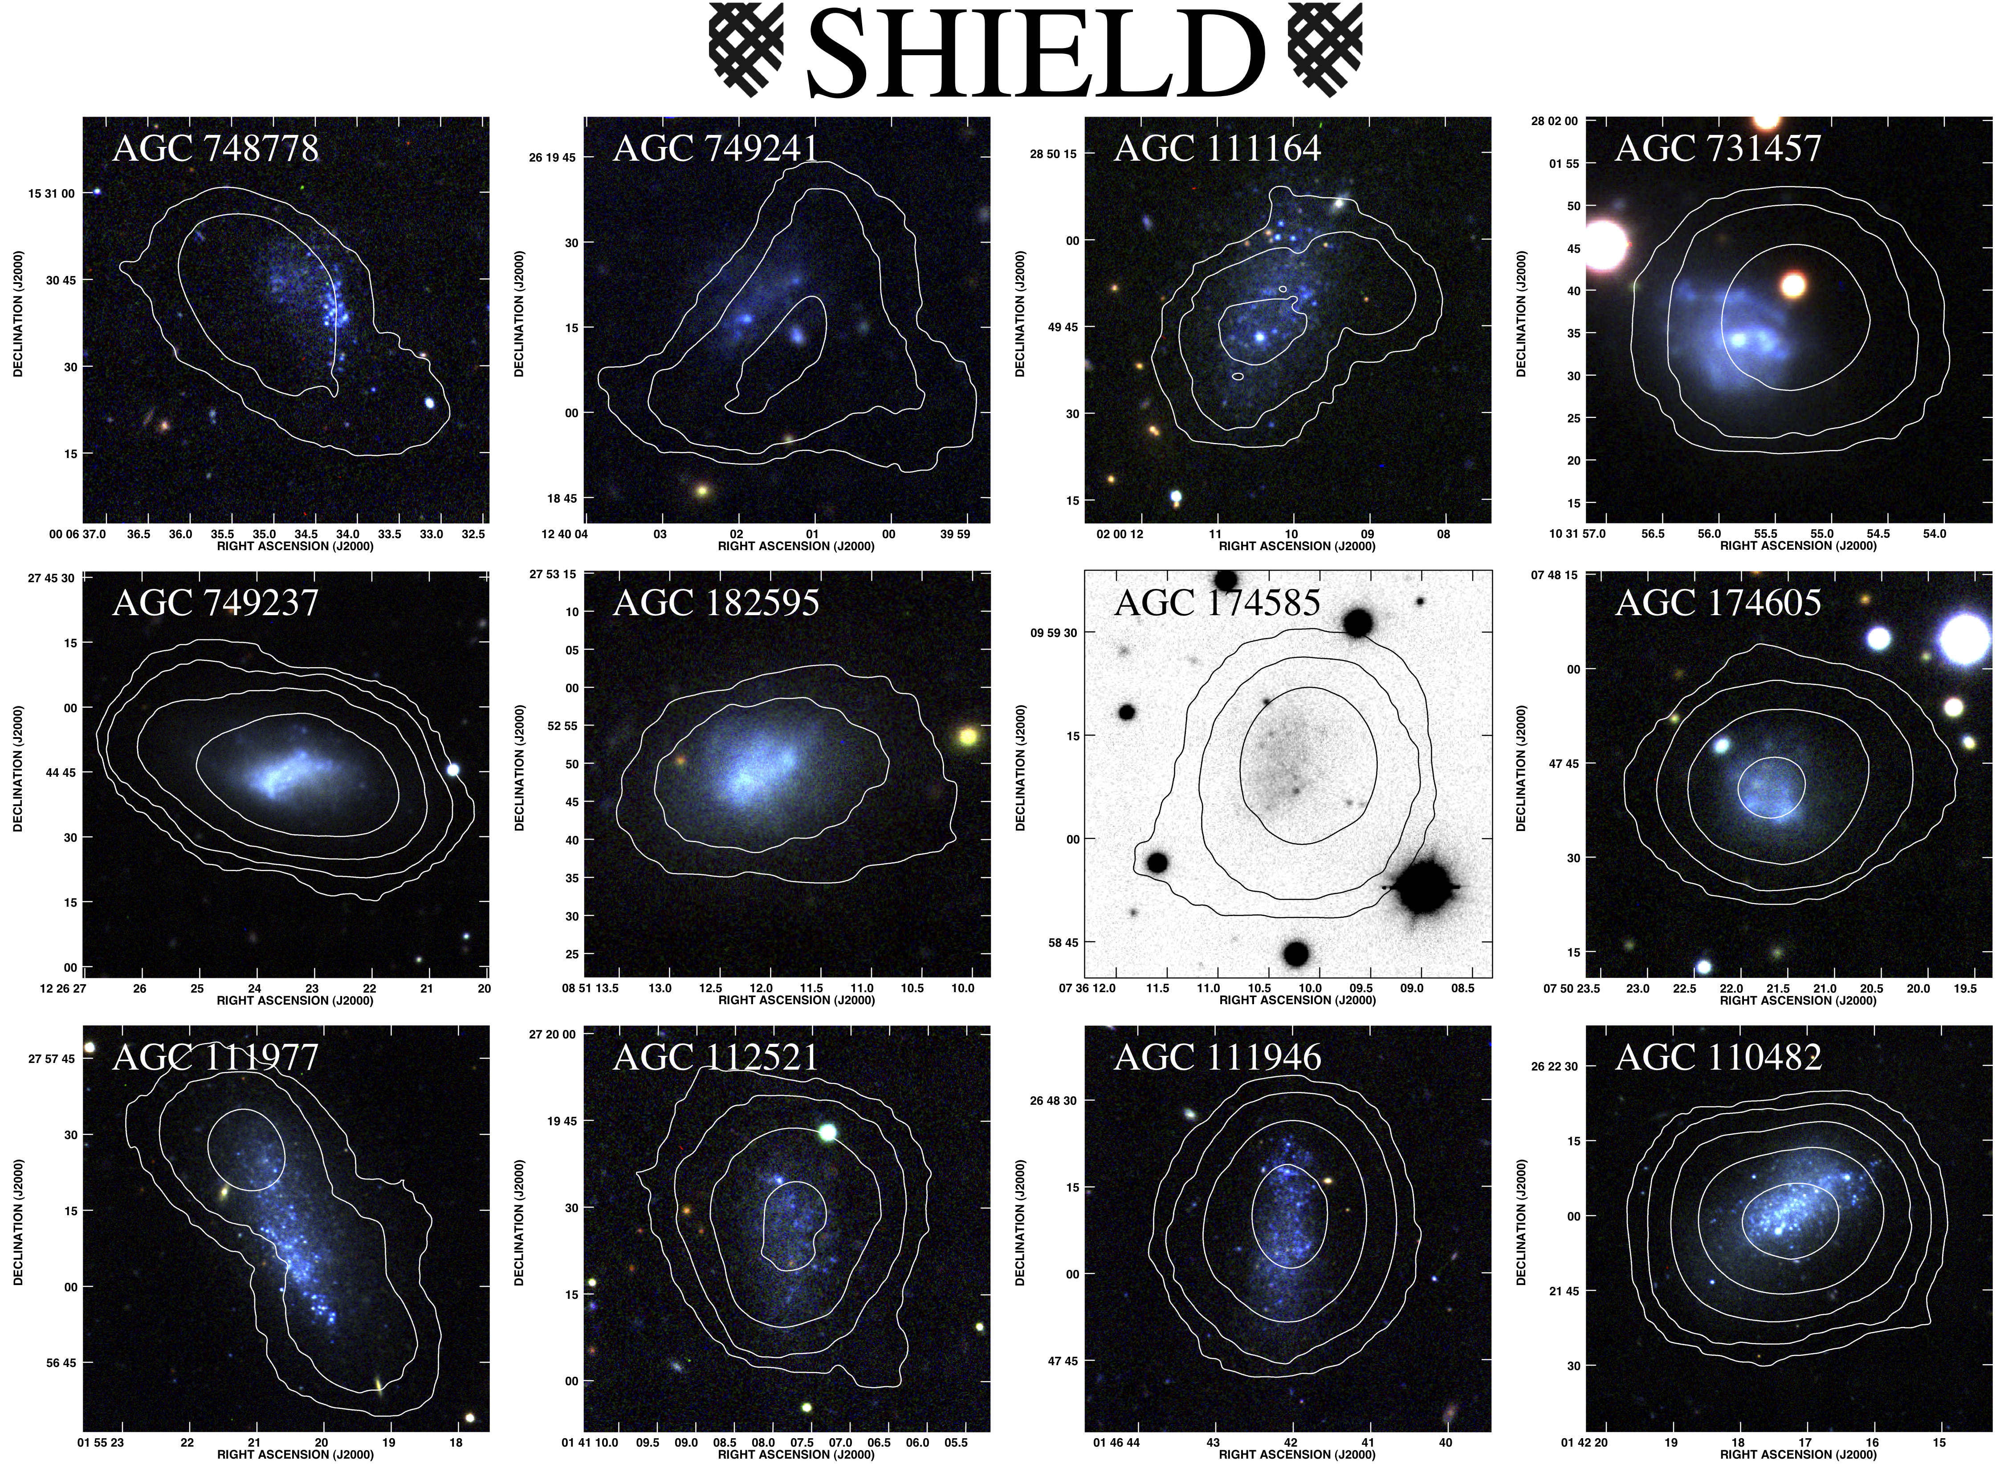
Notes:
748778: D = 5.4 Mpc, M = 3.2 E 6
749241: D = 4.3 Mpc, M = 3.3 E 6
111164: D = 5.9 Mpc, M = 5.4 E 6
731457: D = 5.4 Mpc, M = 4.3 E 6
749237: D = 3.2 Mpc, M = 4.4 E 6
182595: D = 6.1 Mpc, M = 4.6 E 6
174585: D = 6.1 Mpc, M = 4.8 E 6
174605: D = 6.0 Mpc, M = 5.6 E 6
111977: D = 5.5 Mpc, M = 6.8 E 6
112521: D = 7.2 Mpc, M = 8.3 E 6
111946: D = 7.2 Mpc, M = 9.3 E 6
110482: D = 7.2 Mpc, M = 1.6 E 7

Slide 10
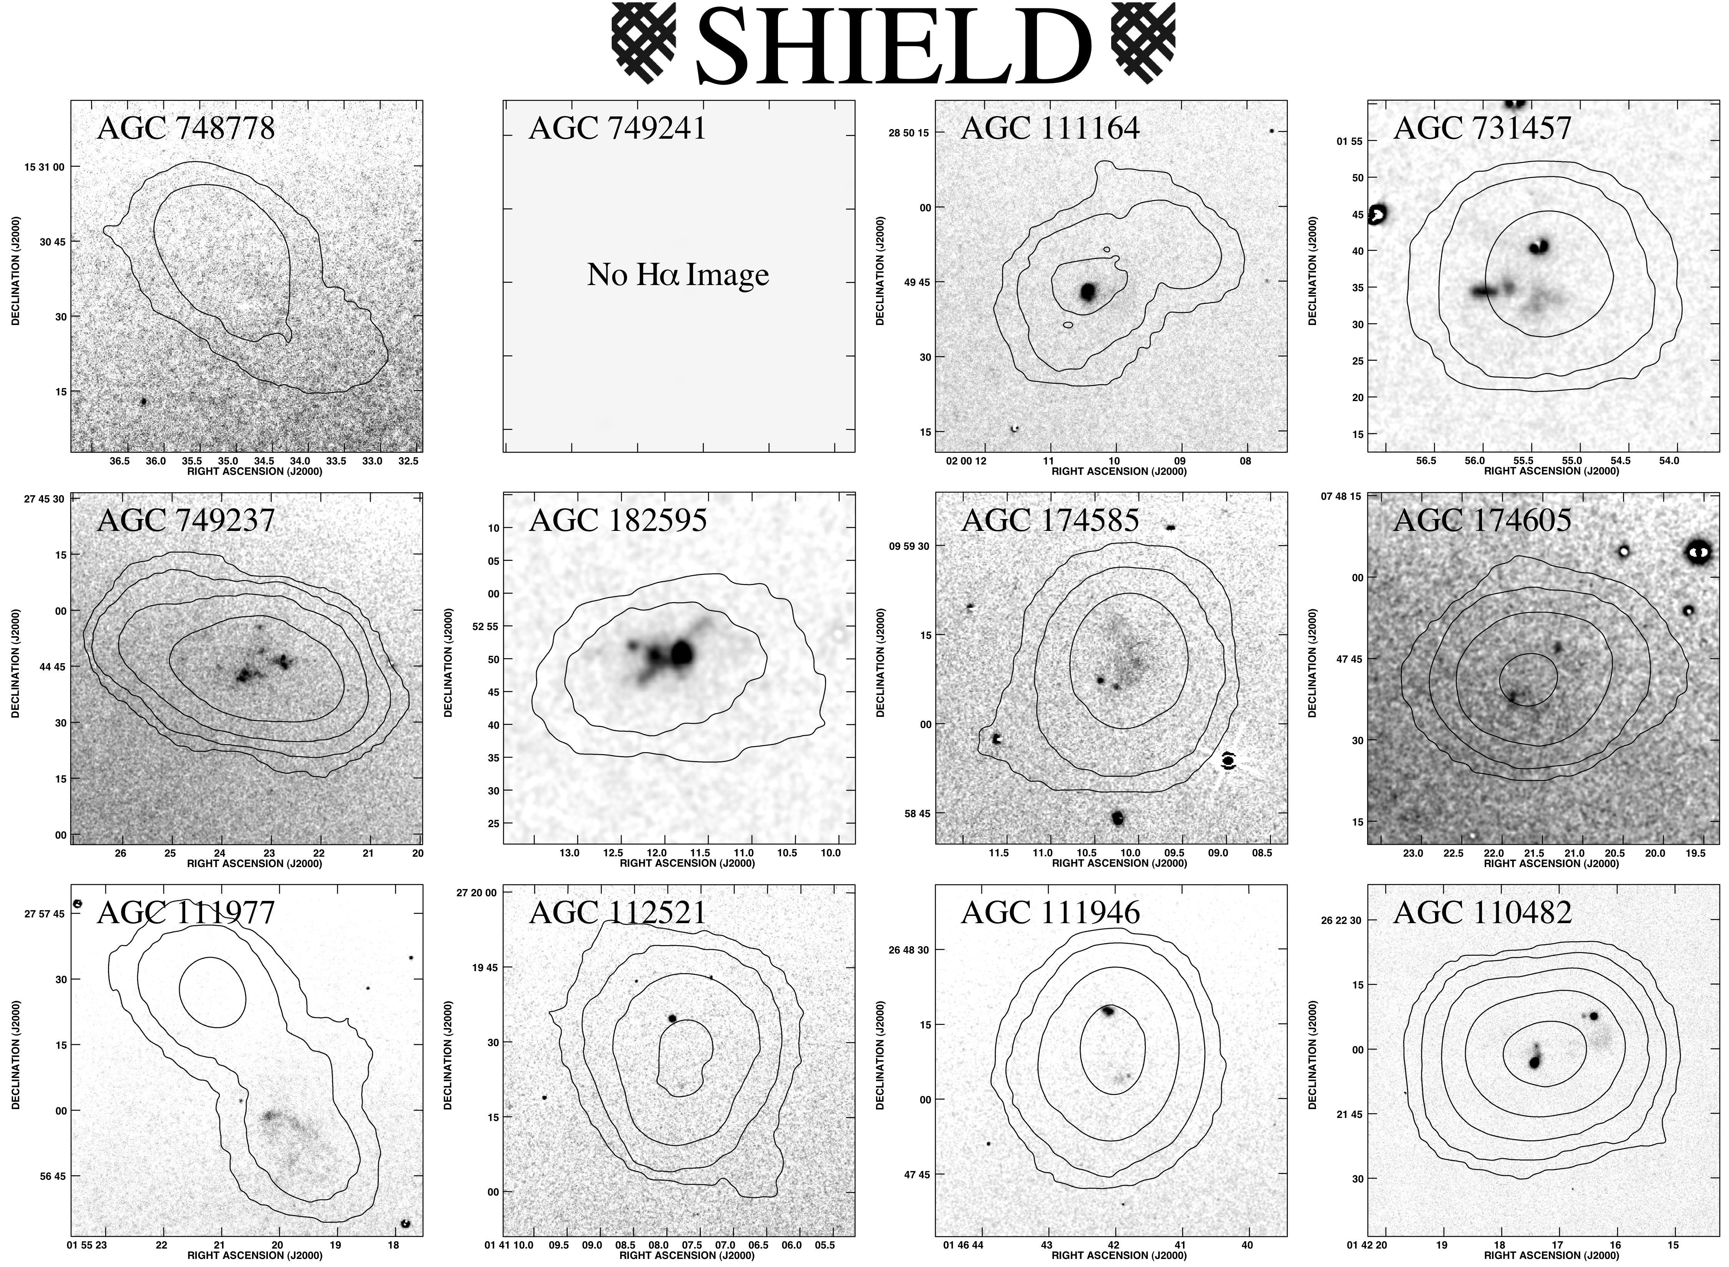
Notes:
Not same physical area shown in each panel

Slide 11
External
Internal
Notes:
748778: D = 5.4 Mpc, M = 3.2 E 6
749241: D = 4.3 Mpc, M = 3.3 E 6
111164: D = 5.9 Mpc, M = 5.4 E 6
731457: D = 5.4 Mpc, M = 4.3 E 6
749237: D = 3.2 Mpc, M = 4.4 E 6
182595: D = 6.1 Mpc, M = 4.6 E 6
174585: D = 6.1 Mpc, M = 4.8 E 6
174605: D = 6.0 Mpc, M = 5.6 E 6
111977: D = 5.5 Mpc, M = 6.8 E 6
112521: D = 7.2 Mpc, M = 8.3 E 6
111946: D = 7.2 Mpc, M = 9.3 E 6
110482: D = 7.2 Mpc, M = 1.6 E 7

Slide 12
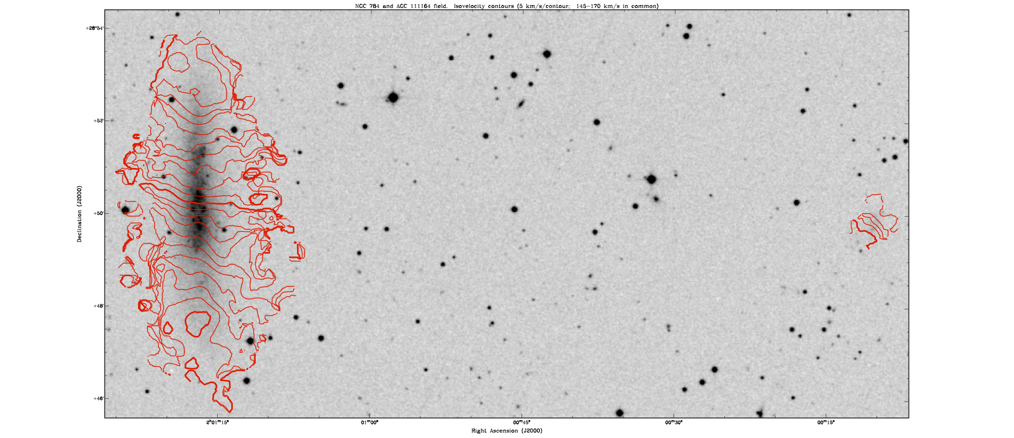
SHIELD: Preliminary Results – AGC 111164
D ≈ 25 kpc
An extremely low-mass, gas-rich satellite, within the virial radius of a relatively massive galaxy
(c.f., Sawala et al. 2011)
Notes:
SAME DISTANCE
NGC 784 roughly 30 times more massive than AGC 111164 – M_HI ~ 4E8 M_SUN

Slide 13
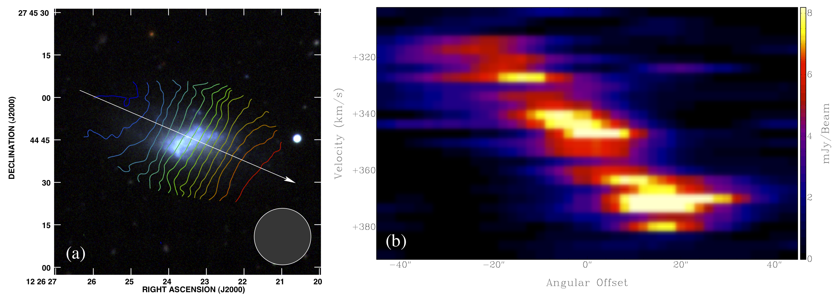
SHIELD: Preliminary Results – AGC 749237
325-370 km s⁻¹, 3 km s⁻¹ intervals
30 km s⁻¹ solid-body rotation at R=620 pc
M_{dyn} ~1x10⁸ M M_{dyn}/M_{baryon} ~ 11
Cannon et al. 2011, ApJ Letters (EVLA Special Edition)
Notes:
Ordered rotation of 30 km/s over 40” angular separation
No inclination correction applied; optical inclination = 56 degrees
M/L assumes equal masses of gas (H + H*0.35 for He) & stars, no molecular gas correction

Slide 14
SHIELD: Preliminary Results
HI distributions are remarkably concentrated
Most systems have coherent rotation
Some systems show incoherent motions and disrupted velocity fields
11 of 12 galaxies have WIYN 3.5m Hα imaging
10 of 11 have active star formation
Only 1 system with N_{HI} > 10²¹ cm⁻² at 20′′ resolution
The SHIELD galaxies are forming stars in conditions different from those seen in more massive systems
Preliminary dynamical analyses reveal high mass-to-light ratios
The SHIELD galaxies have retained baryons inside halos of total mass <10⁸ M
Among the lowest-mass gas-bearing halos known

Slide 15
SHIELD: Preliminary Results
Are the SHIELD galaxies part of the population that will solve the missing satellite problem?
Number density of these systems (with stellar populations) appears too low
However, models predict a substantial population of halos of similar mass without a stellar population
ALFALFA continues to search and find both
The galaxy population to which the SHIELD members belong remains cosmologically critical
Most systems of this dynamical mass have (apparently) been destroyed
How have the systems discovered to date survived?

Slide 16
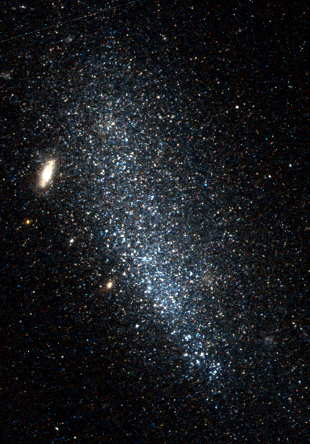
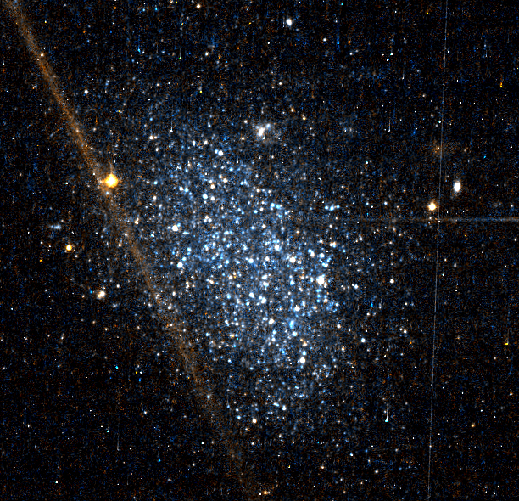
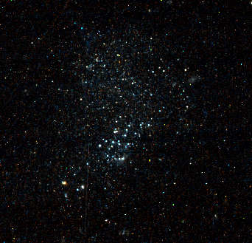
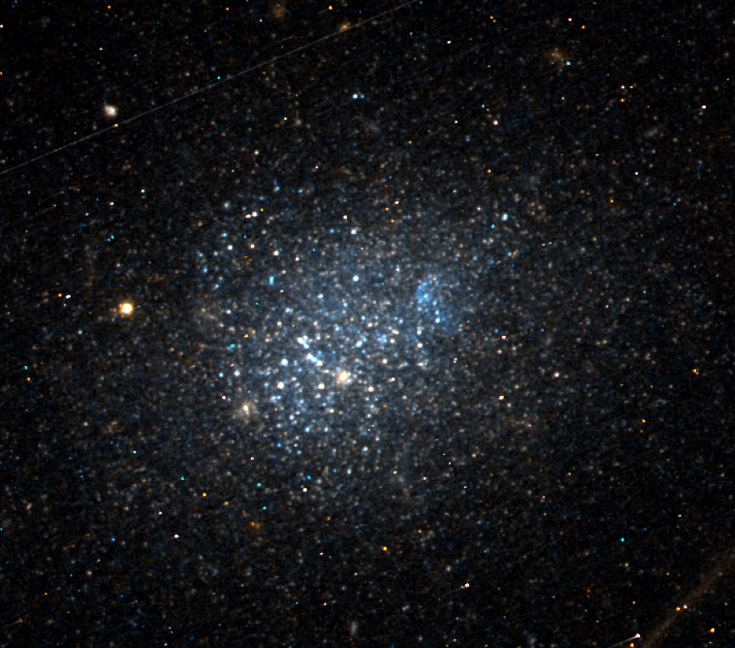
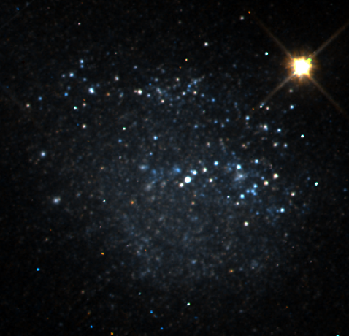
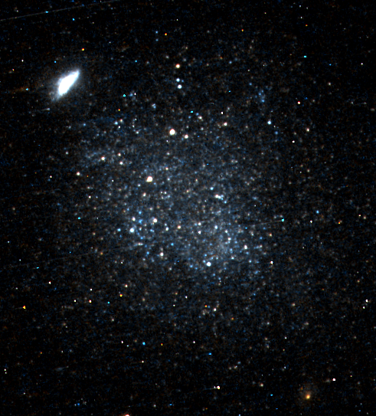
SHIELD: The Next Steps – HST Imaging
AGC 174585
AGC 111977
AGC 748778
AGC 174605
AGC 182595
AGC 731457

Slide 17
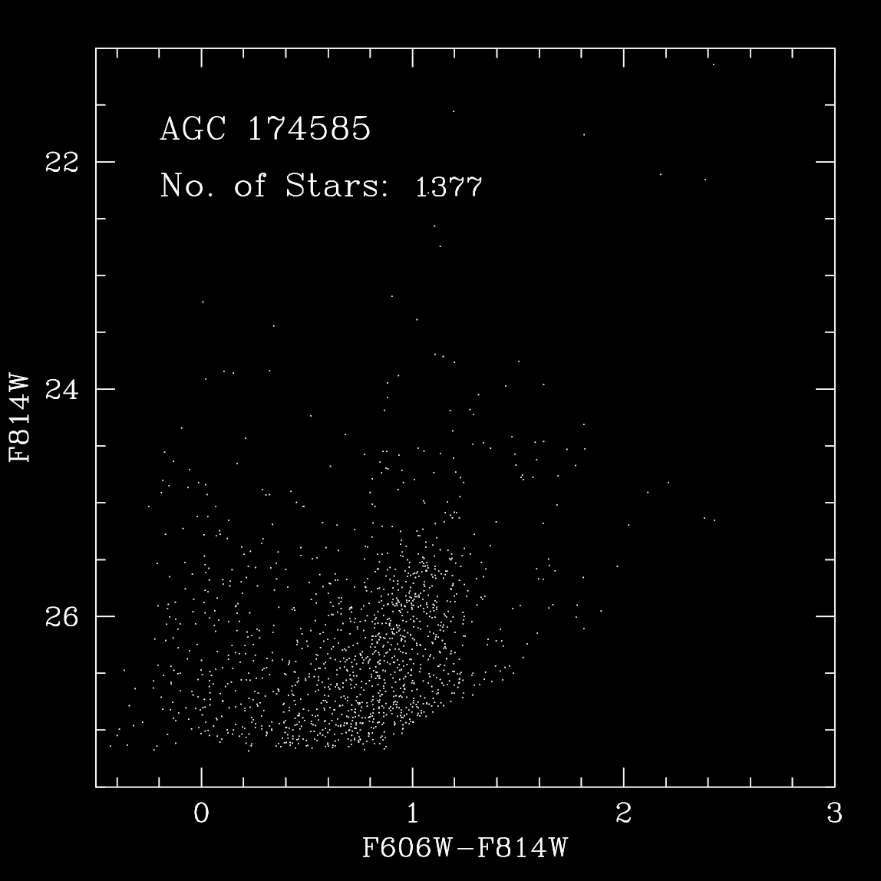
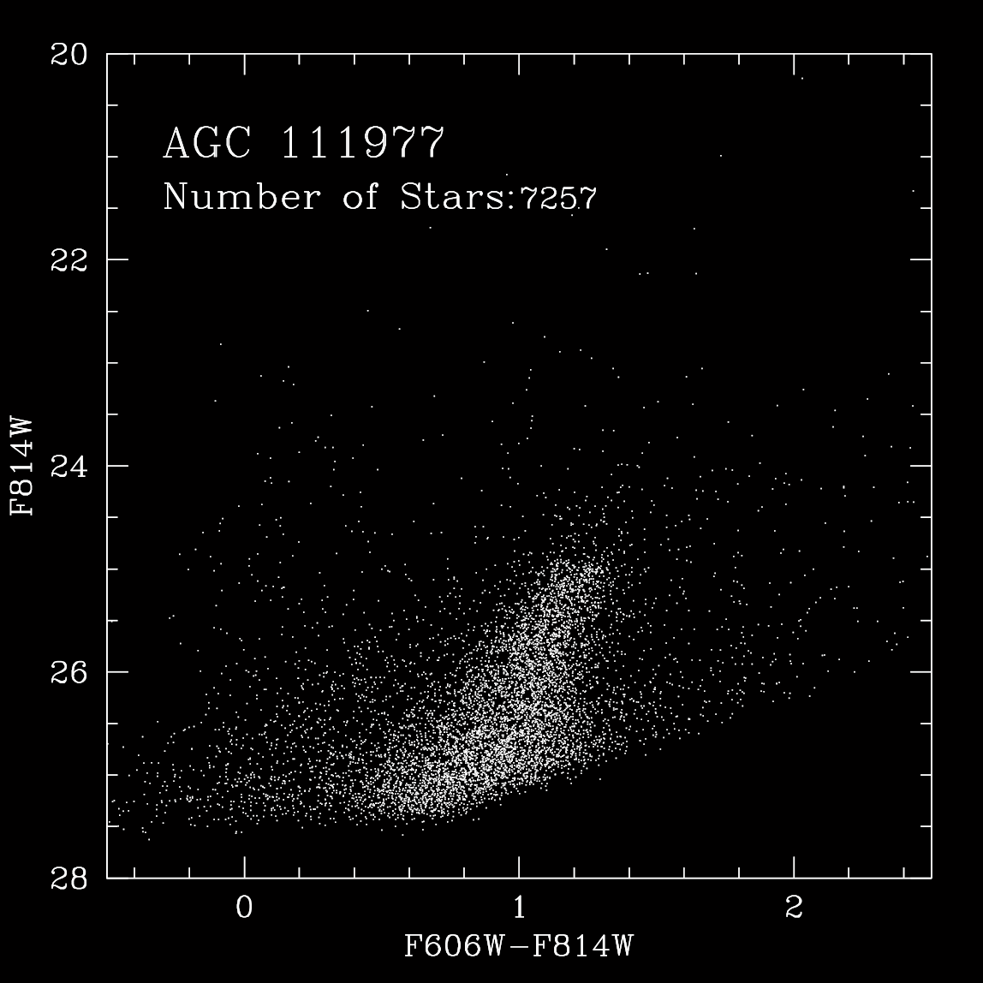
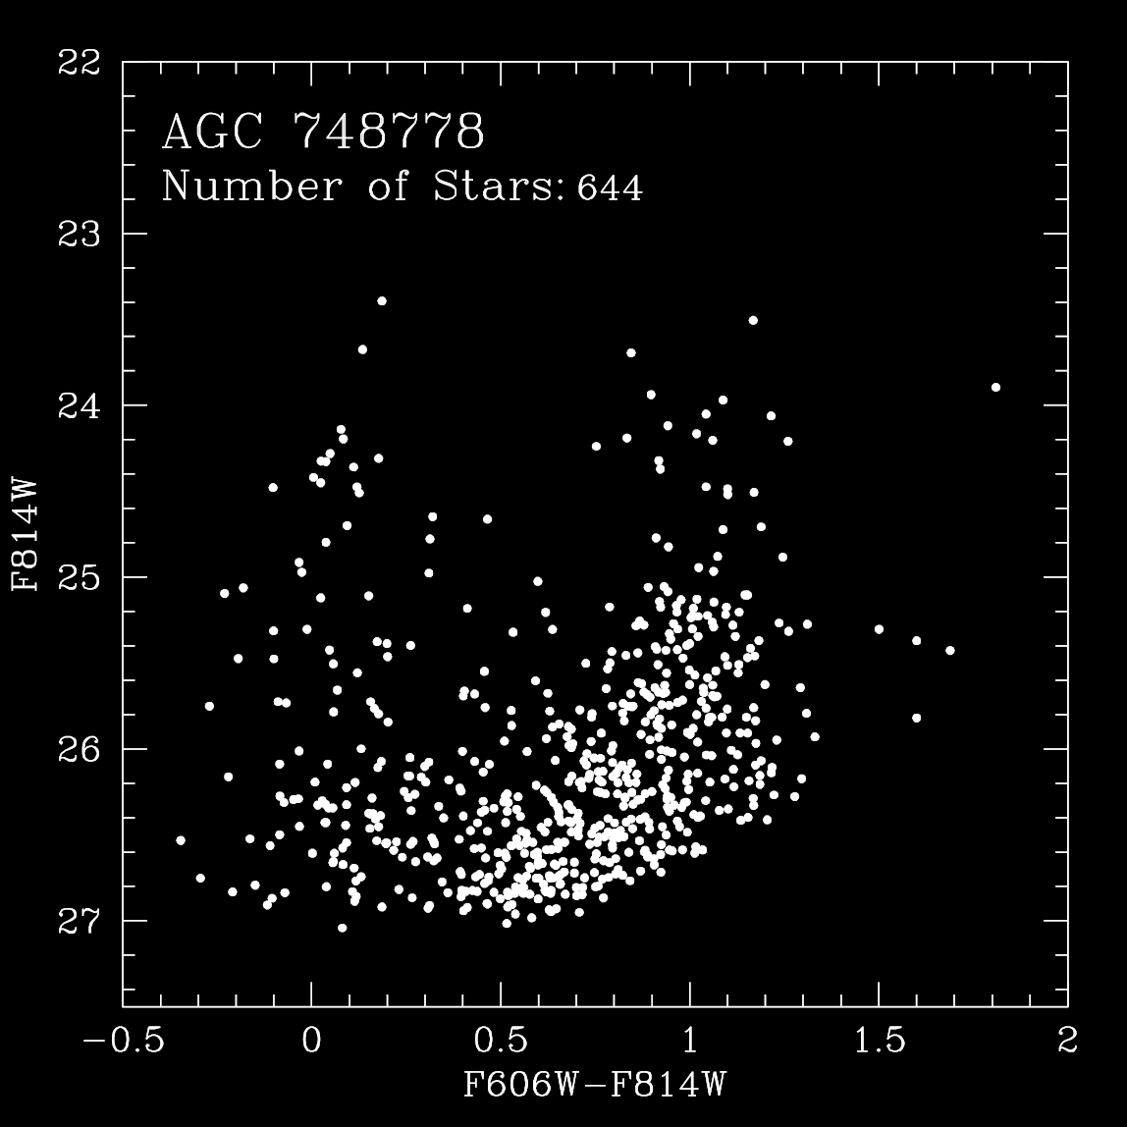
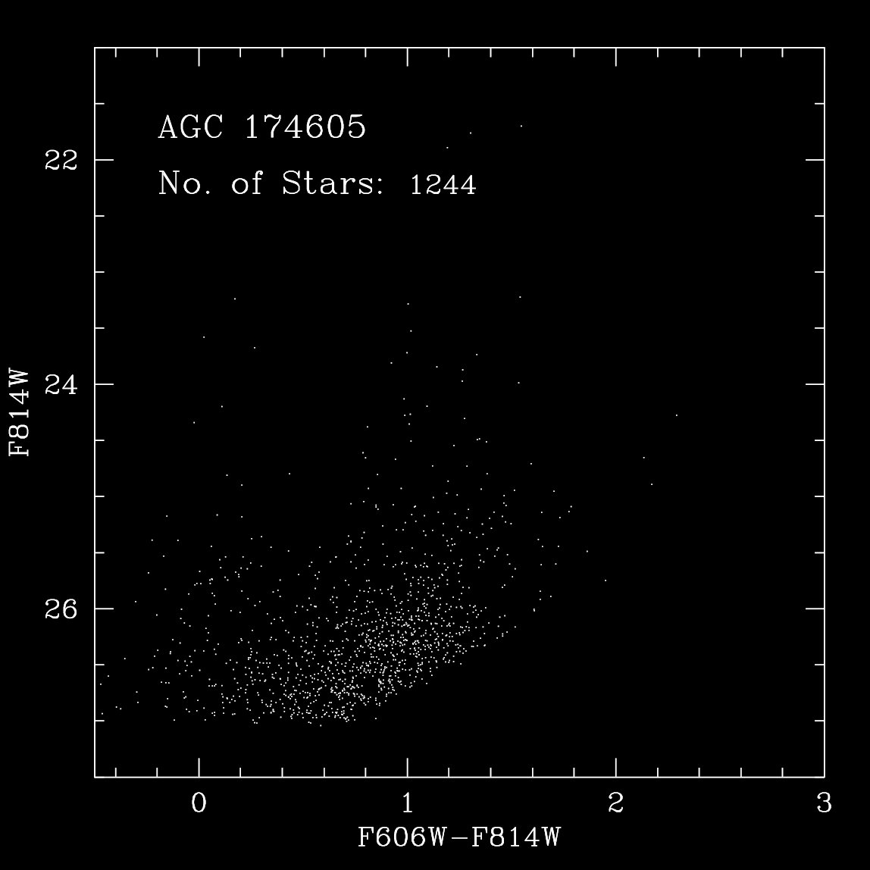
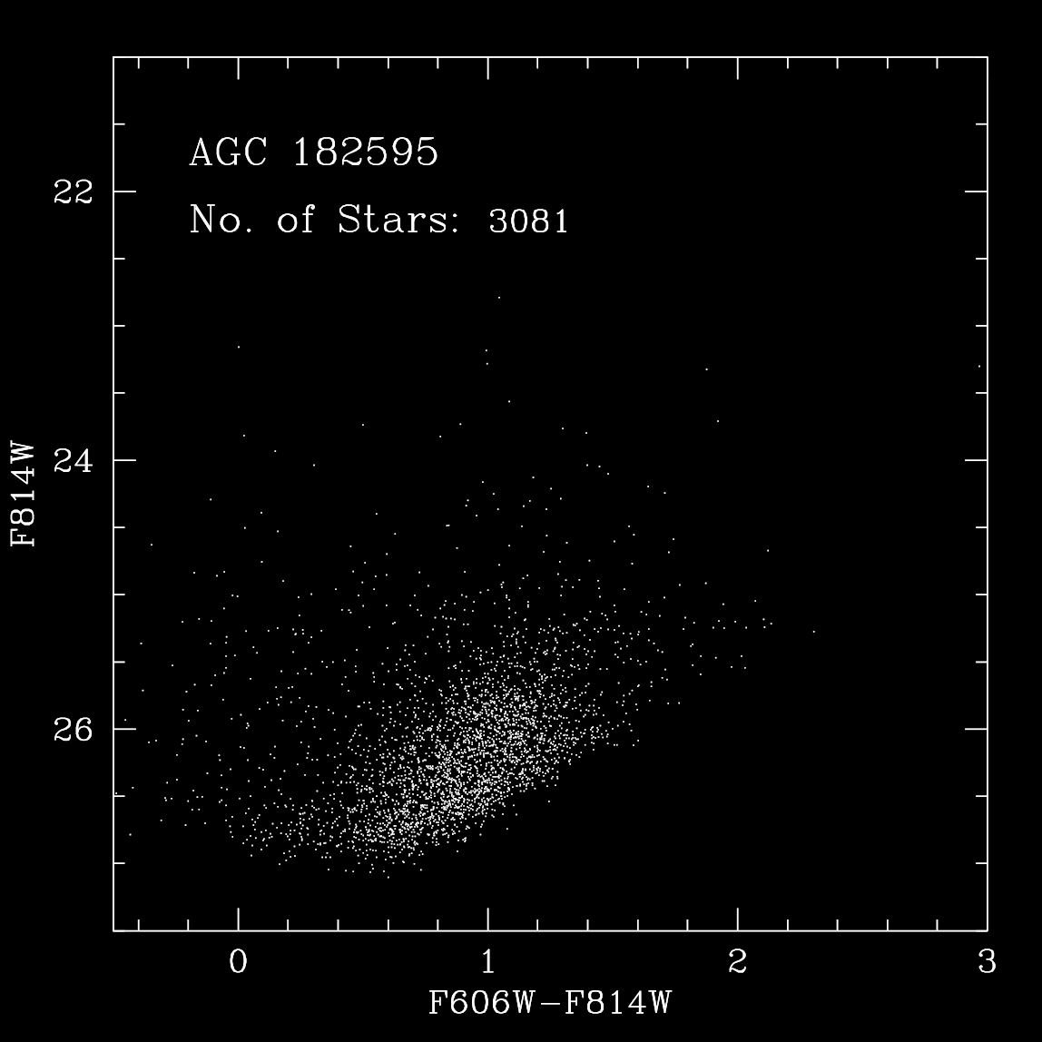
SHIELD: The Next Steps – HST Imaging
AGC 174585
AGC 111977
AGC 748778
AGC 174605
AGC 182595

Slide 18
SHIELD: The Next Steps – HST Imaging
AGC 111977
TRGB = distance
D = 5.1±0.5 Mpc
M_{HI} = 5.2x10⁶ M
Notes:
S_HI = 0.85 Jy km/s
D=5.1 Mpc
M_HI = 5.2E6 M_sun

Slide 19
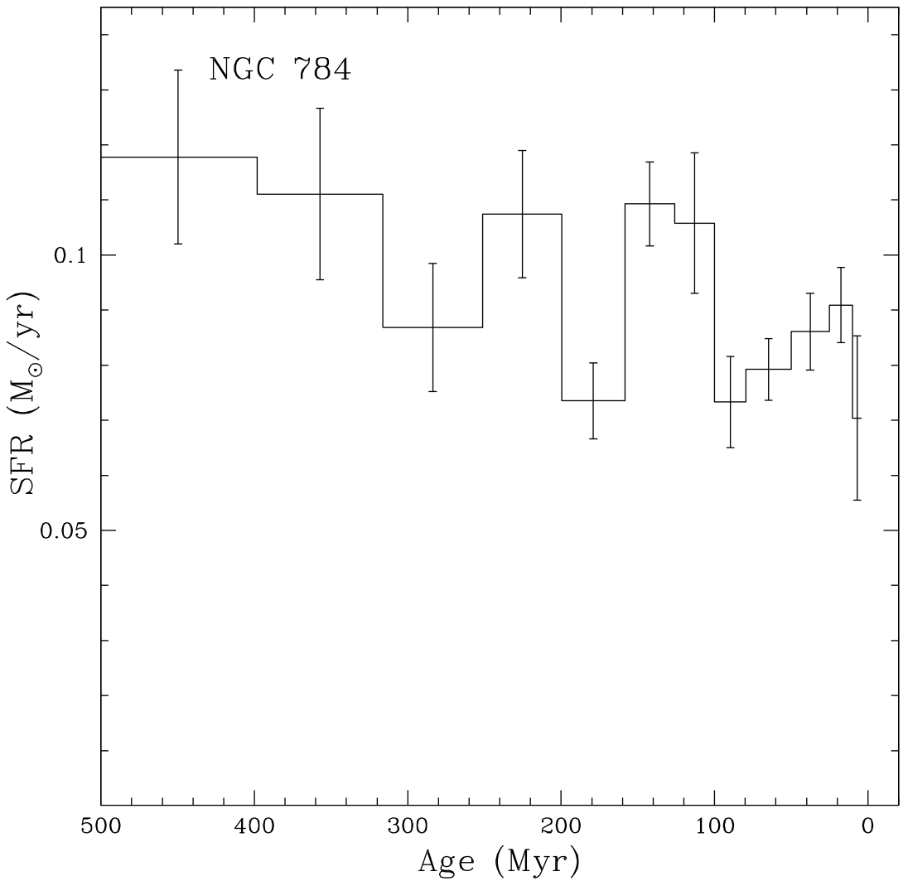
SHIELD: The Next Steps – HST Imaging
MS
BHeB
McQuinn et al. (2010)

Slide 20
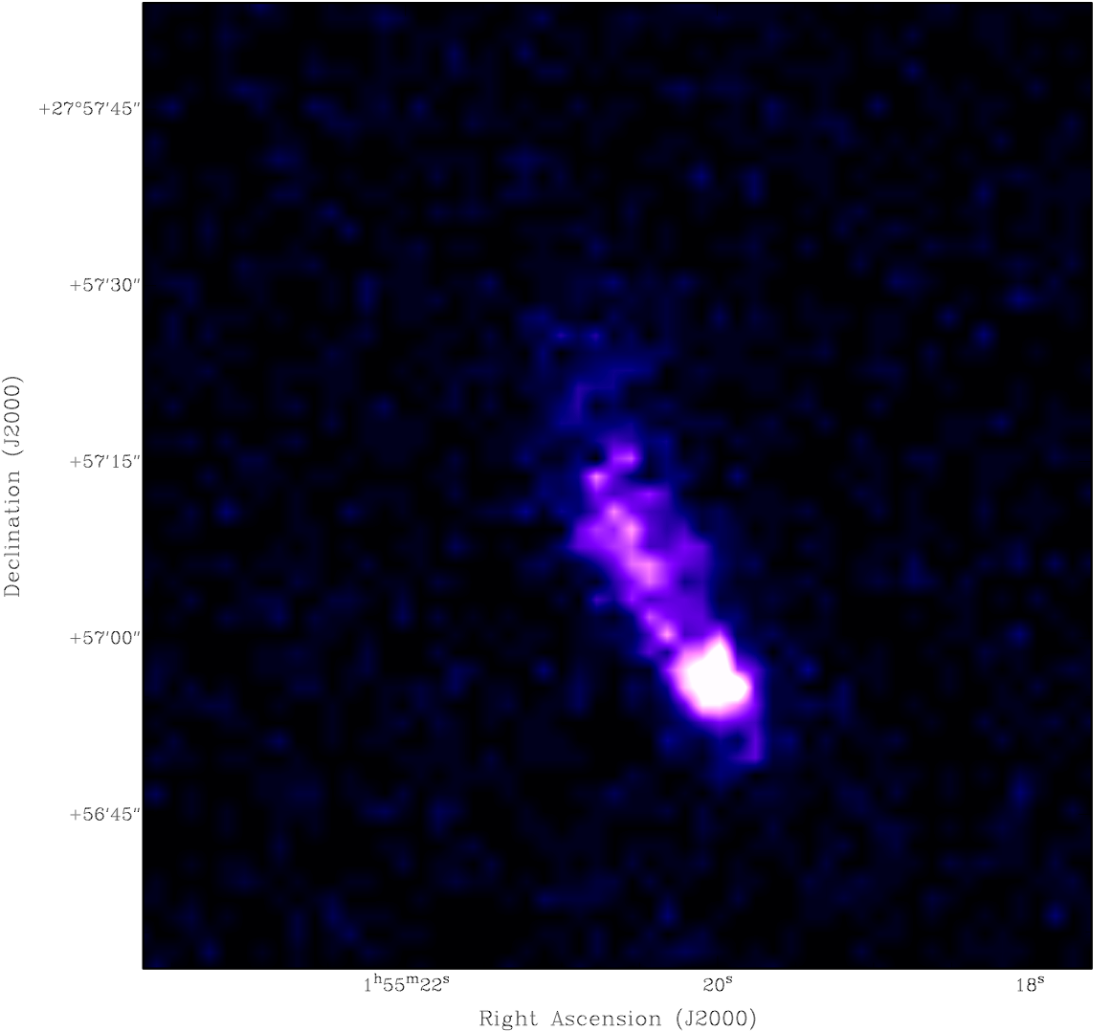
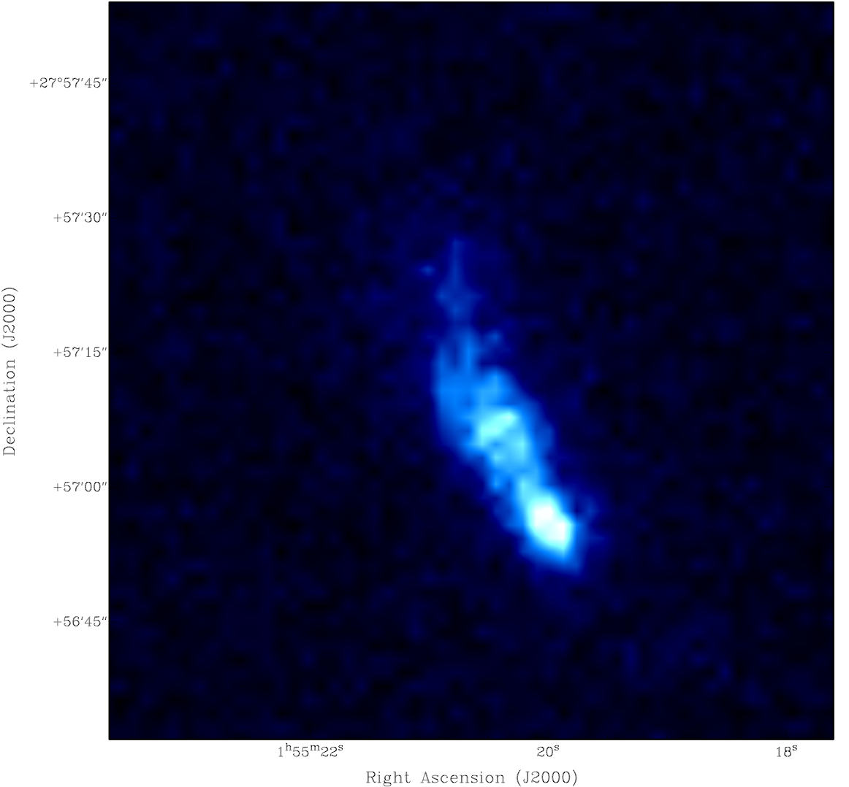
SHIELD: The Next Steps – GALEX Imaging
FUV luminosity = SFR (hundreds of Myr)

Slide 21
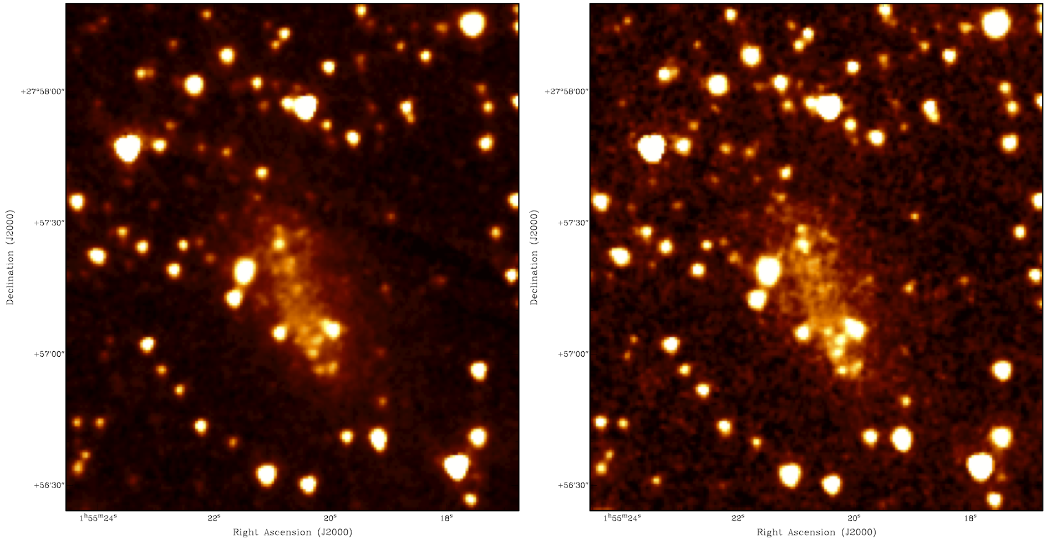
SHIELD: The Next Steps – Spitzer Imaging
IR luminosity = stellar mass

Slide 22
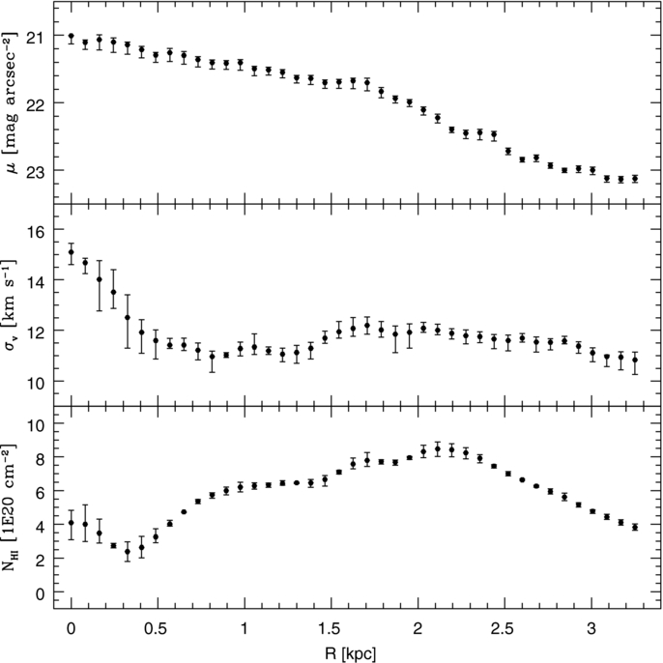
SHIELD: The Next Steps – Spitzer Imaging
IR surface brightness = stellar mass distribution

Slide 23
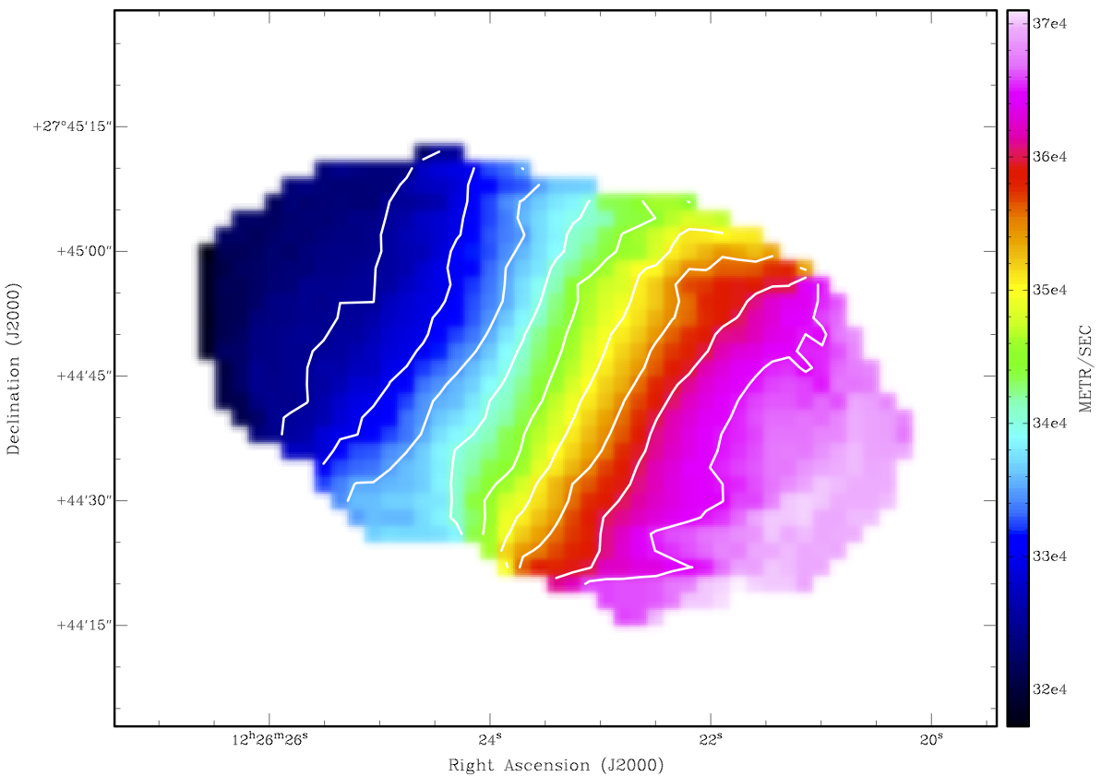
SHIELD: The Next Steps – Dynamical Modeling
System most amenable to rotation curve analysis is AGC 749237
High resolution data analyzed by Macalester student Clara Thomann ’13 and Ed Elson (ICRAR)

Slide 24
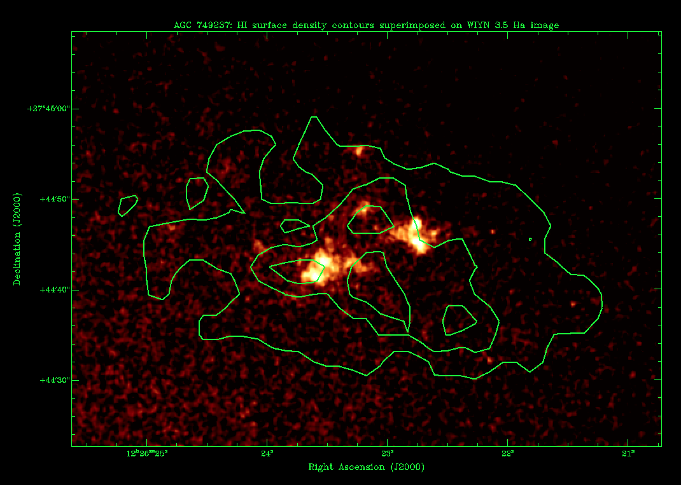
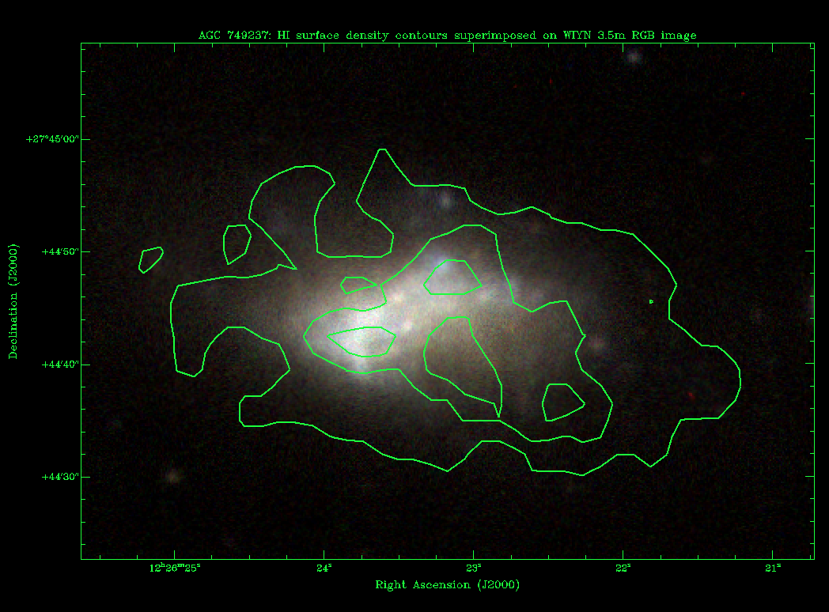
SHIELD: The Next Steps – Dynamical Modeling
Thomann et al. (2012)

Slide 25
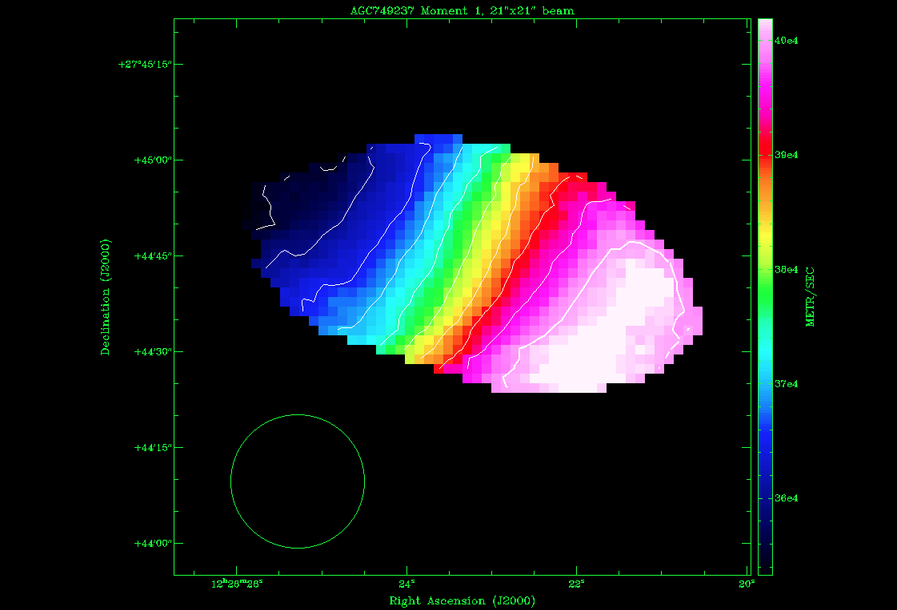
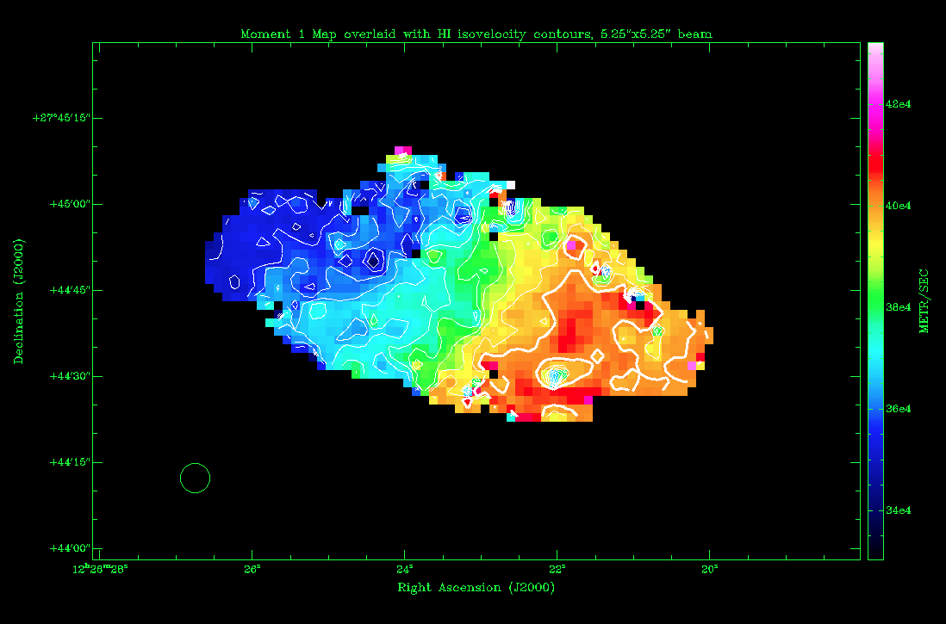
SHIELD: The Next Steps – Dynamical Modeling
Thomann et al. (2012)

Slide 26
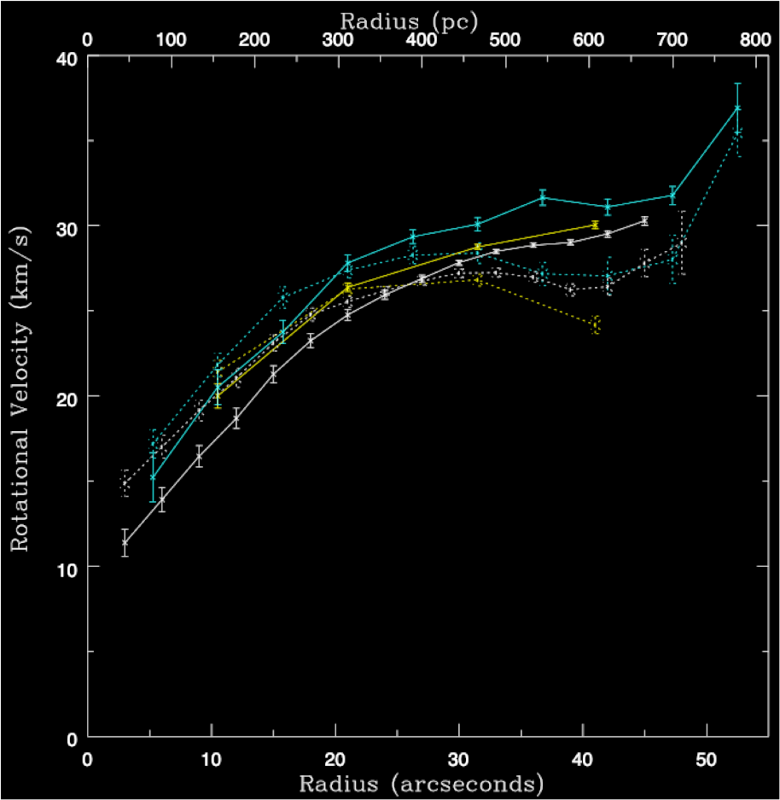
SHIELD: The Next Steps – Dynamical Modeling
M_{dyn} =(1.1±0.2)x10⁸ M
Thomann et al. (2012)
Notes:
HST plan window: April 26 – May 16
INCL = 57 degrees

Slide 27
SHIELD: The Next Steps
EVLA imaging in hand
Combine EVLA + Arecibo datasets
Examine ALFALFA grids for gas-rich companions
Spitzer warm imaging provides stellar masses
GALEX images will reveal patterns of star formation over 100-Myr timescales
WIYN 3.5m imaging (BVR+Hα) continues in 2012
KPNO/KOSMOS spectroscopy coming soon
VLT IFU datasets under analysis

Slide 28
SHIELD: The Next Steps – Synthesis

Slide 29
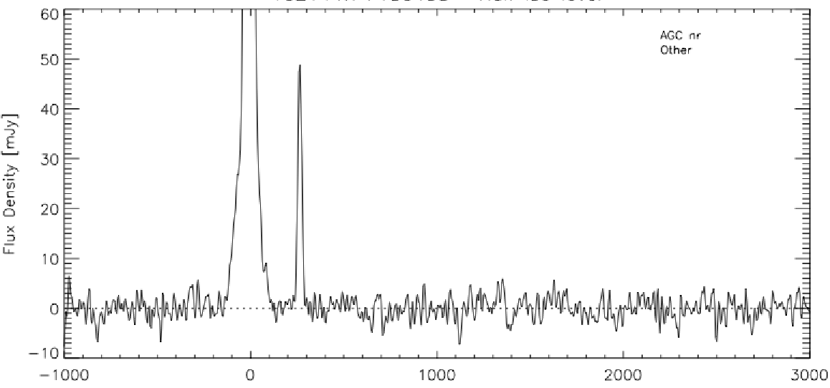
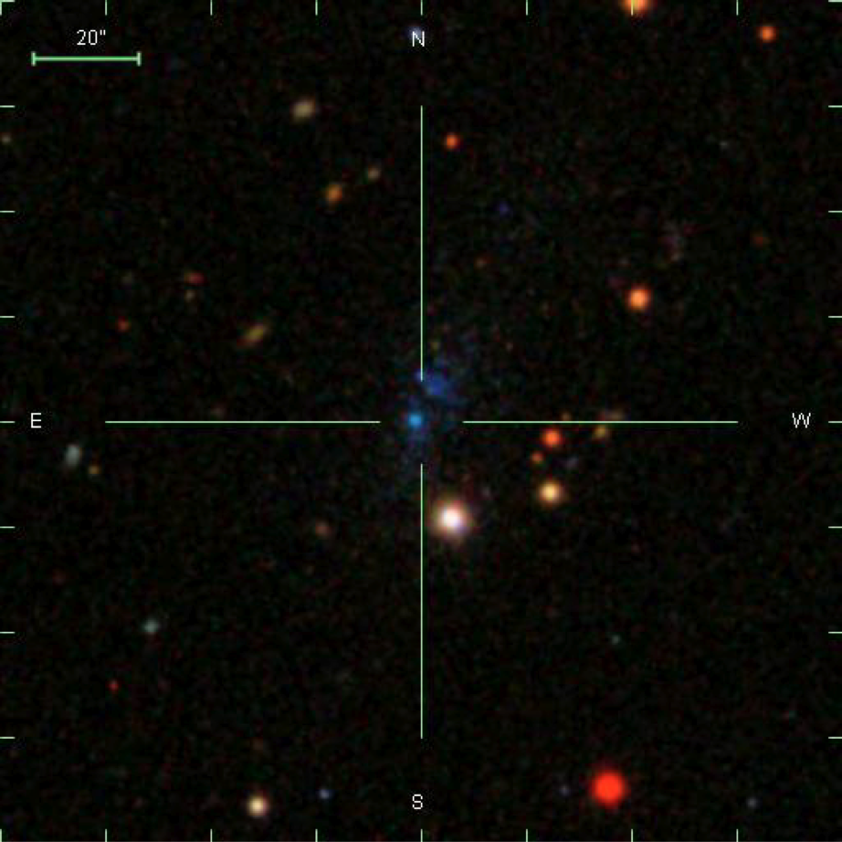
Beyond SHIELD: Harvesting ALFALFA

Slide 30
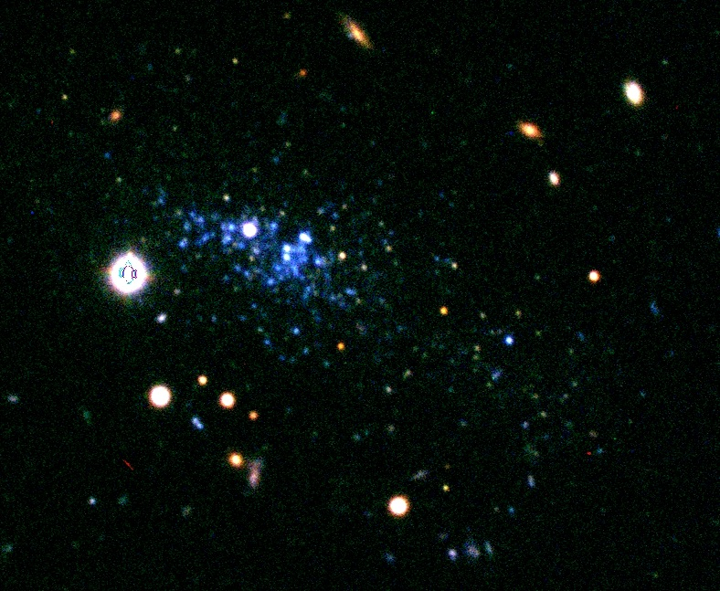
Beyond SHIELD: Harvesting ALFALFA
Notes:
HI mass < 10^ solar Masses

Slide 31
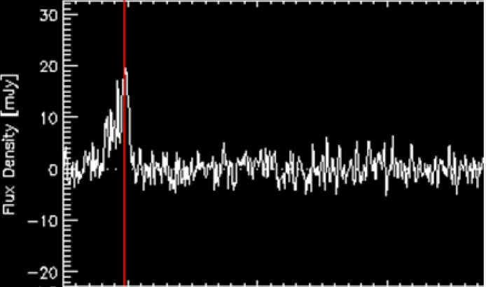
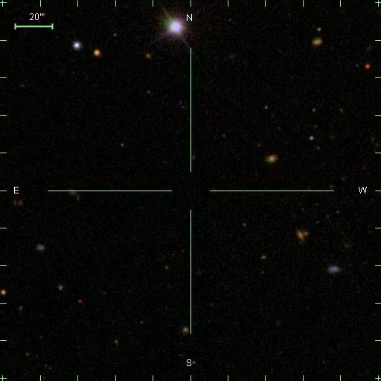
Beyond SHIELD: Harvesting ALFALFA

Slide 32
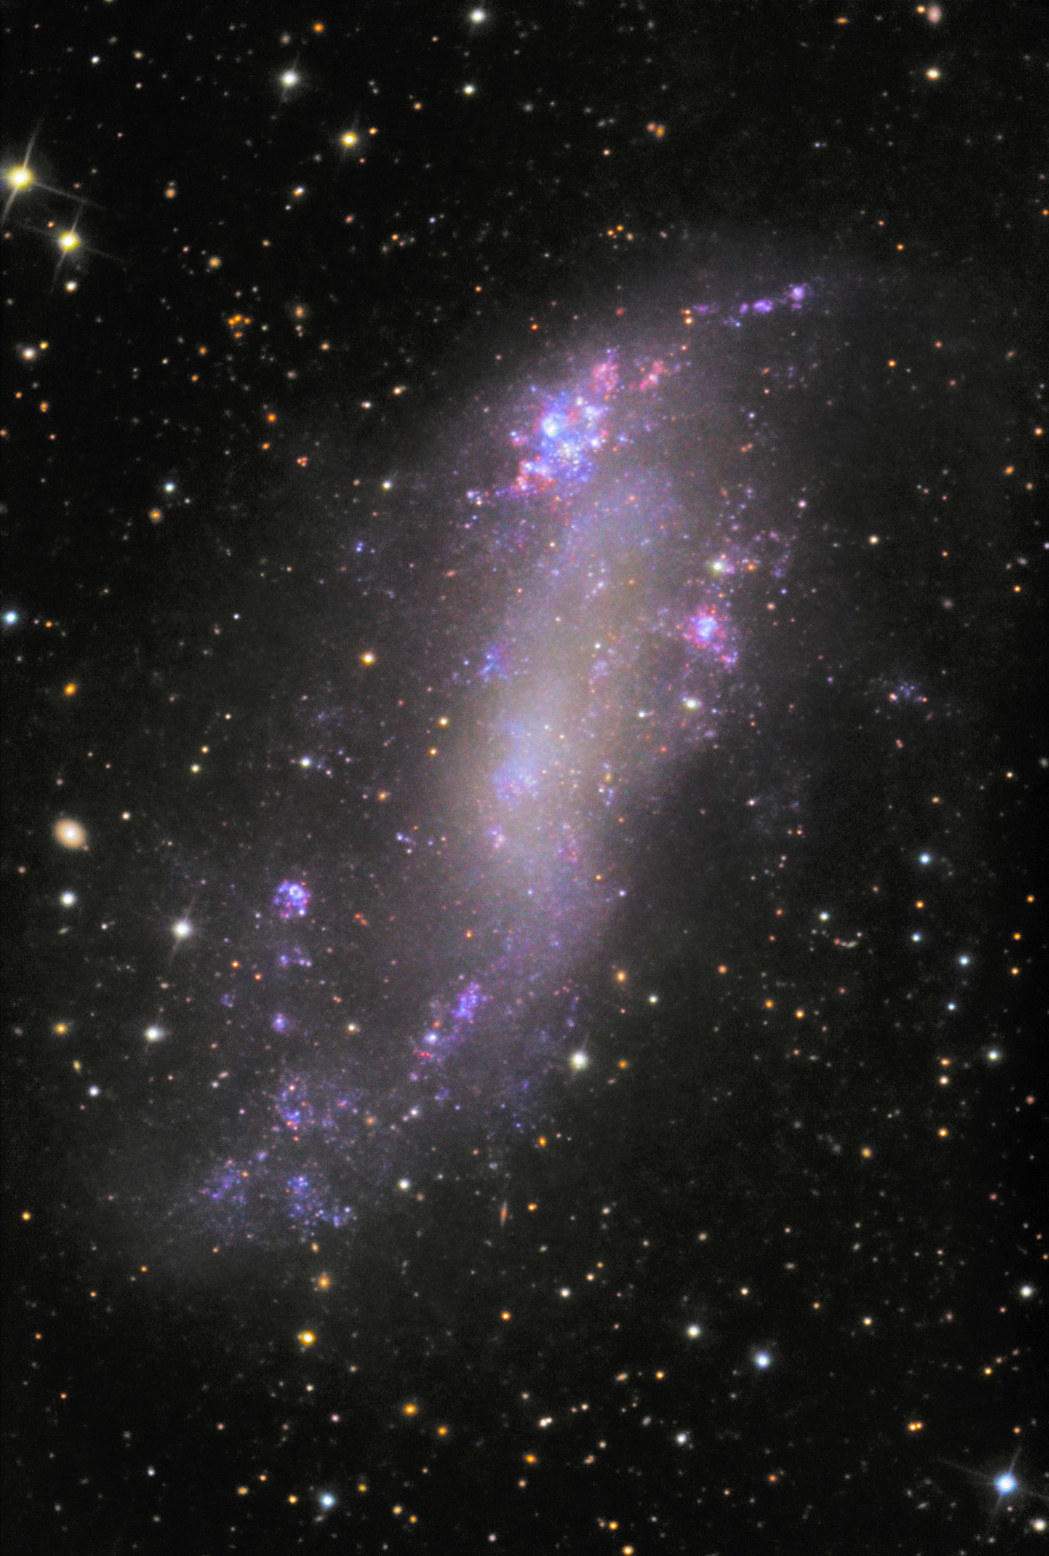
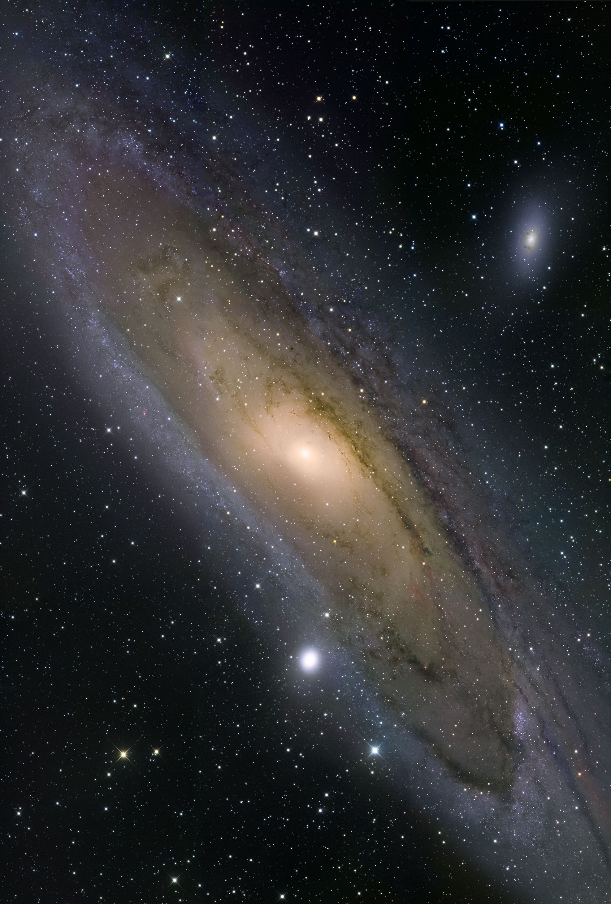
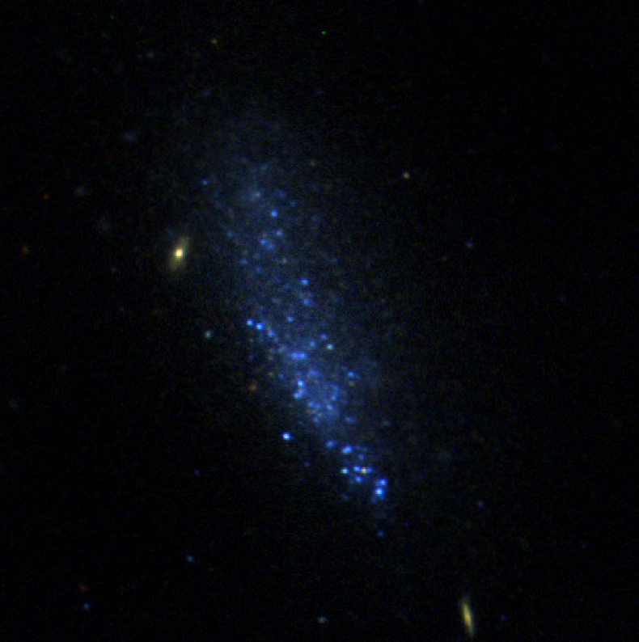
ALFALFA: Long-Term Prospectus
A very bright future for very dim galaxies
Well-studied
f_{b} ~ 0.01
f_{b} ~ 0.16
10⁵
10⁶
10⁷
10⁸
10⁹
10¹⁰
10^{10.5}
M_{HI} (M)
M_{dyn} (M)
10⁷
10⁸
10⁸
10⁹
10⁹
10¹⁰
10¹¹
10¹²

