Slide 1
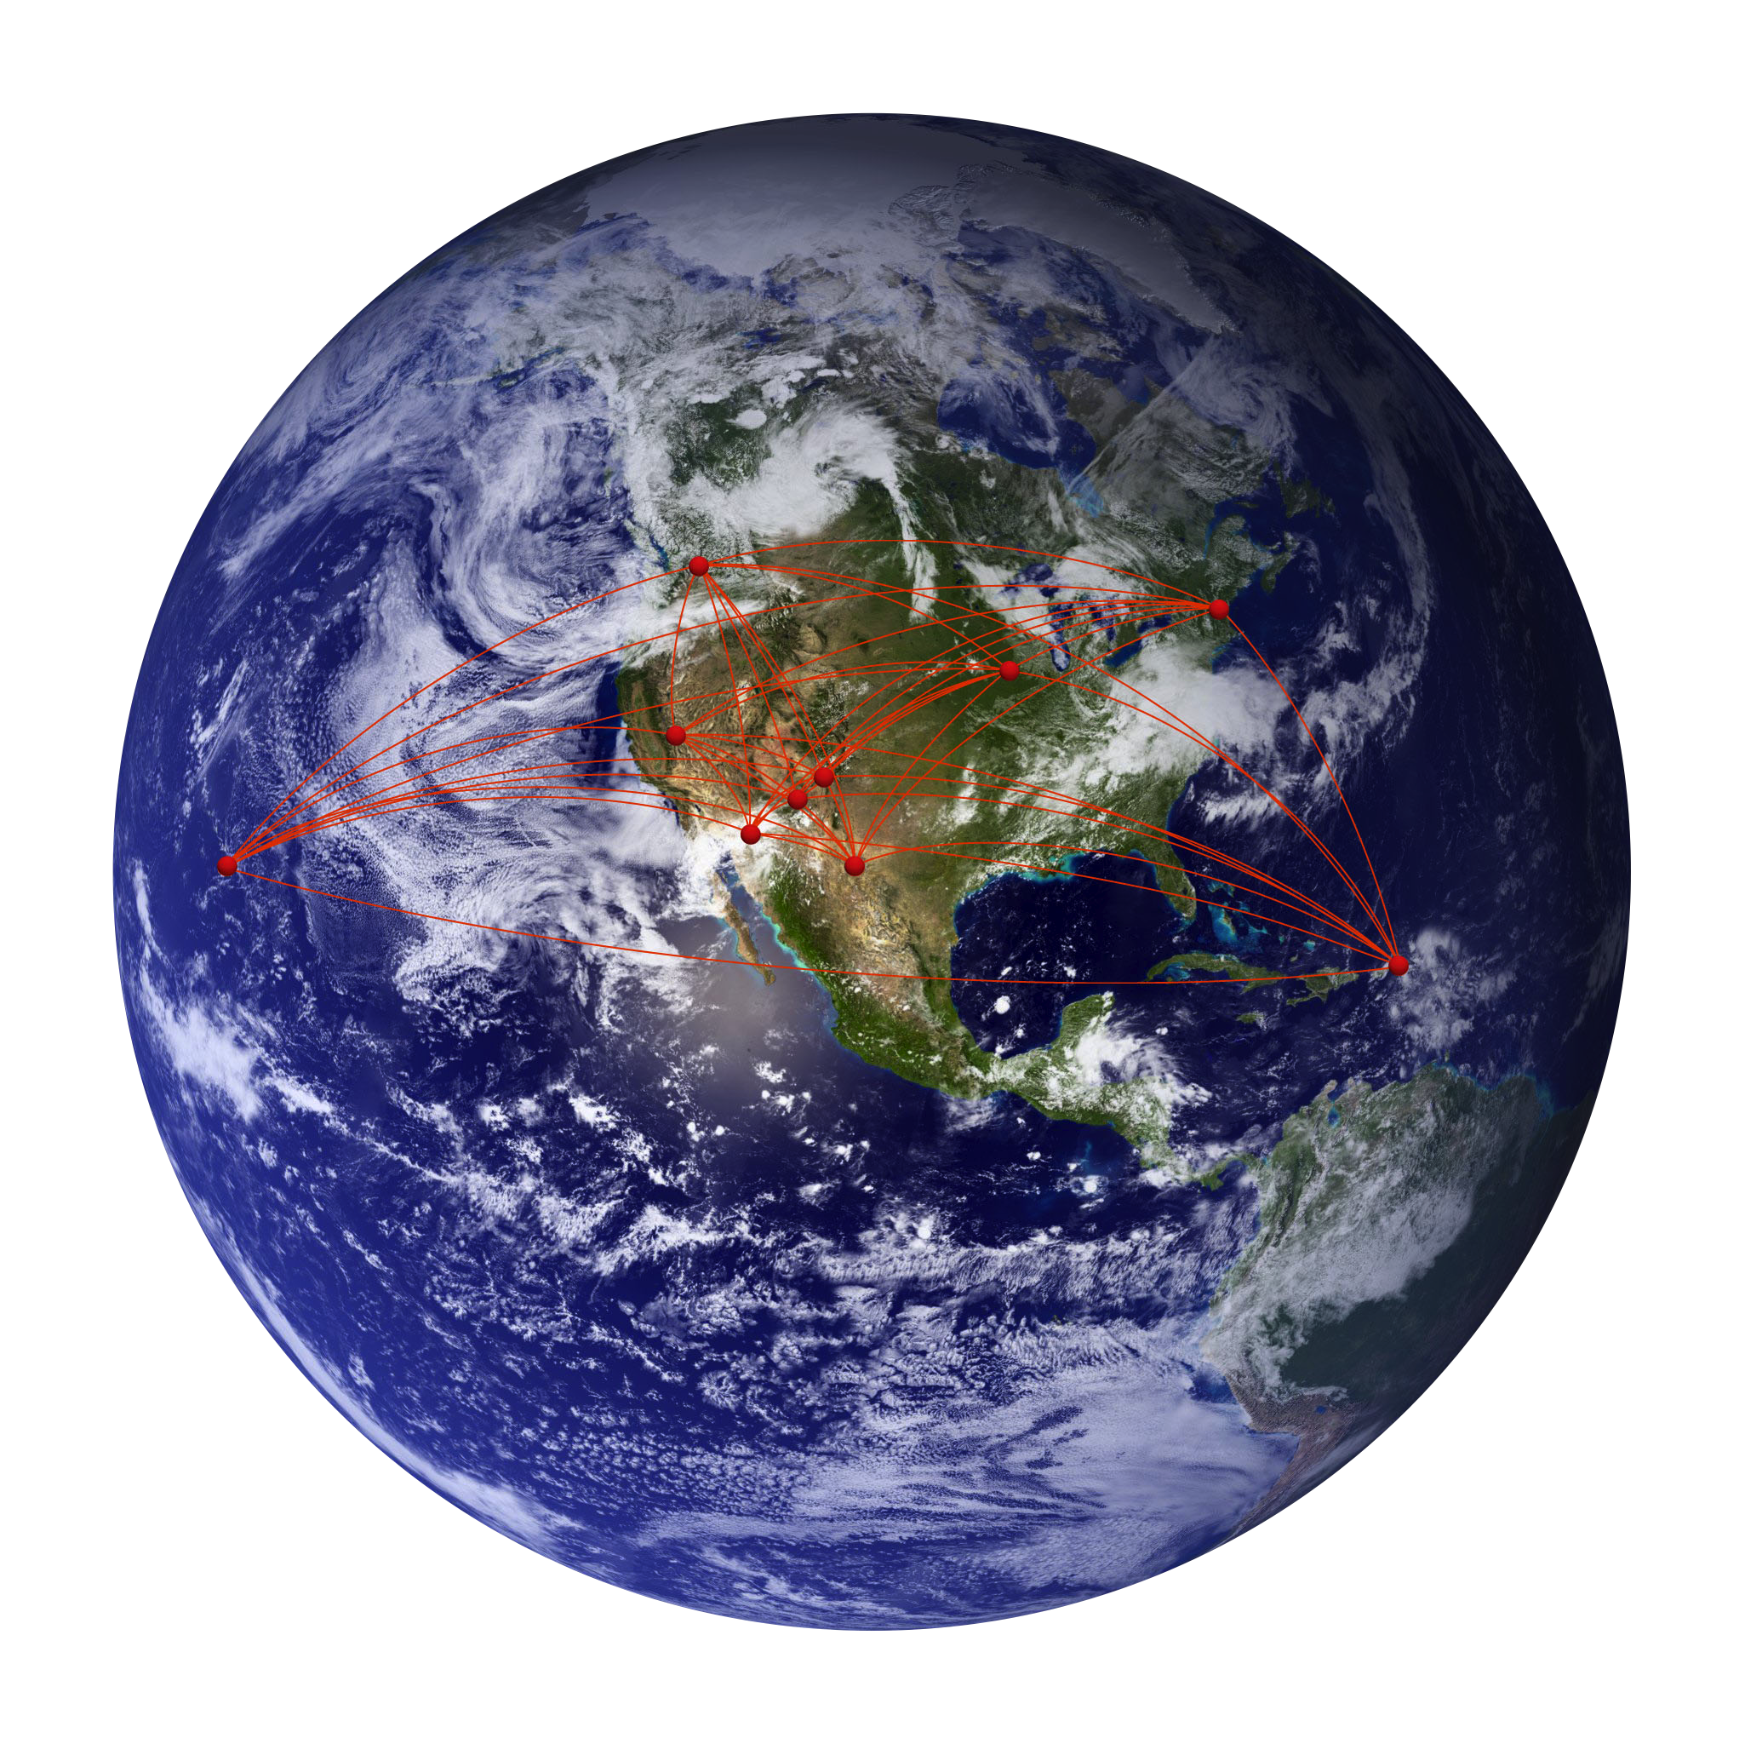
Measuring Distances to Galaxies Using
Water Vapor Megamasers
Jim Braatz (NRAO)

Slide 2
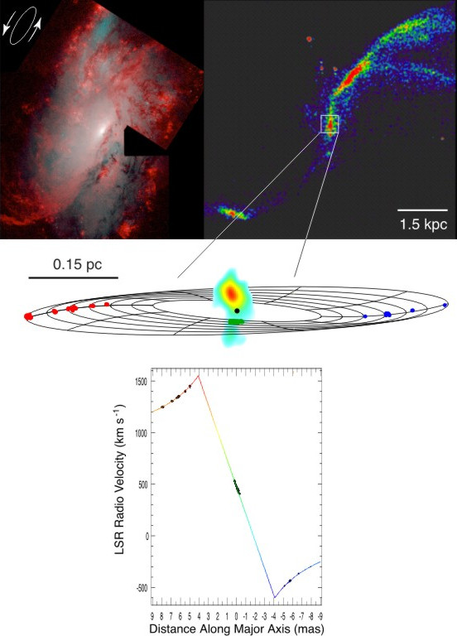

Measuring Distances to H₂O Megamasers
NGC 4258
Thin-ring model:
D = a⁻¹ k^{2/3} Ω^{4/3}
a = acceleration
v = k r ^{-1/2}
Ω = slope of sys features
Δθ
V_{r}
2V_{r}
2Δθ
7.2 ± 0.5 Mpc : Herrnstein et al. (1999))

Slide 3

The Megamaser Cosmology Project
Braatz, Condon, Reid, Henkel & Lo
Kuo, Impellizzeri, Gao, Huchra & Greene
The MCP is an NRAO “Key Project” with the goal of determining H₀ precisely (goal 3%) by measuring geometric distances to about 10 galaxies in the Hubble flow.
Survey with the GBT to identify maser disk galaxies
Image the sub-pc disks with the High Sensitivity Array (VLBA+GBT+EB)
Measure accelerations in the disk with GBT monitoring
Model the maser disk dynamics and determine distance to the host galaxy

Slide 4
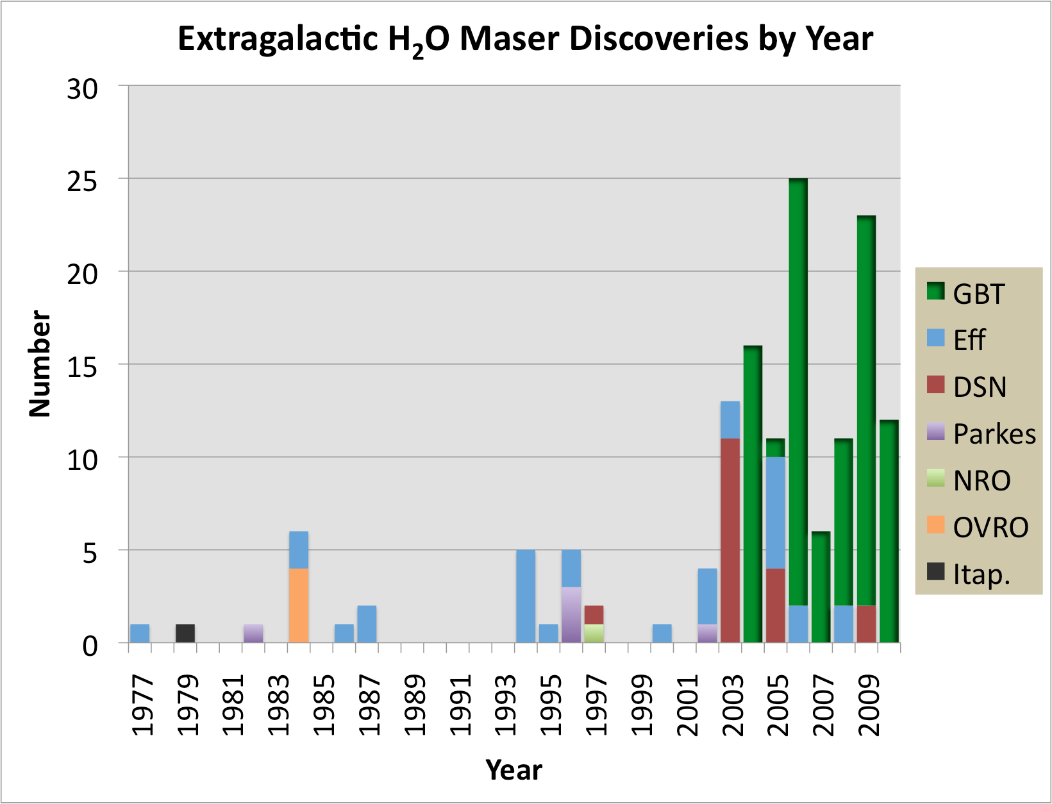
Progress with Megamaser Surveys
150 galaxies detected
> 3000 observed
~ 30 have evidence of being in a disk
~ 10 suitable for distance measurement
Primary sample for surveys: Type 2 AGNs from SDSS, 6dF, 2MRS

Slide 5
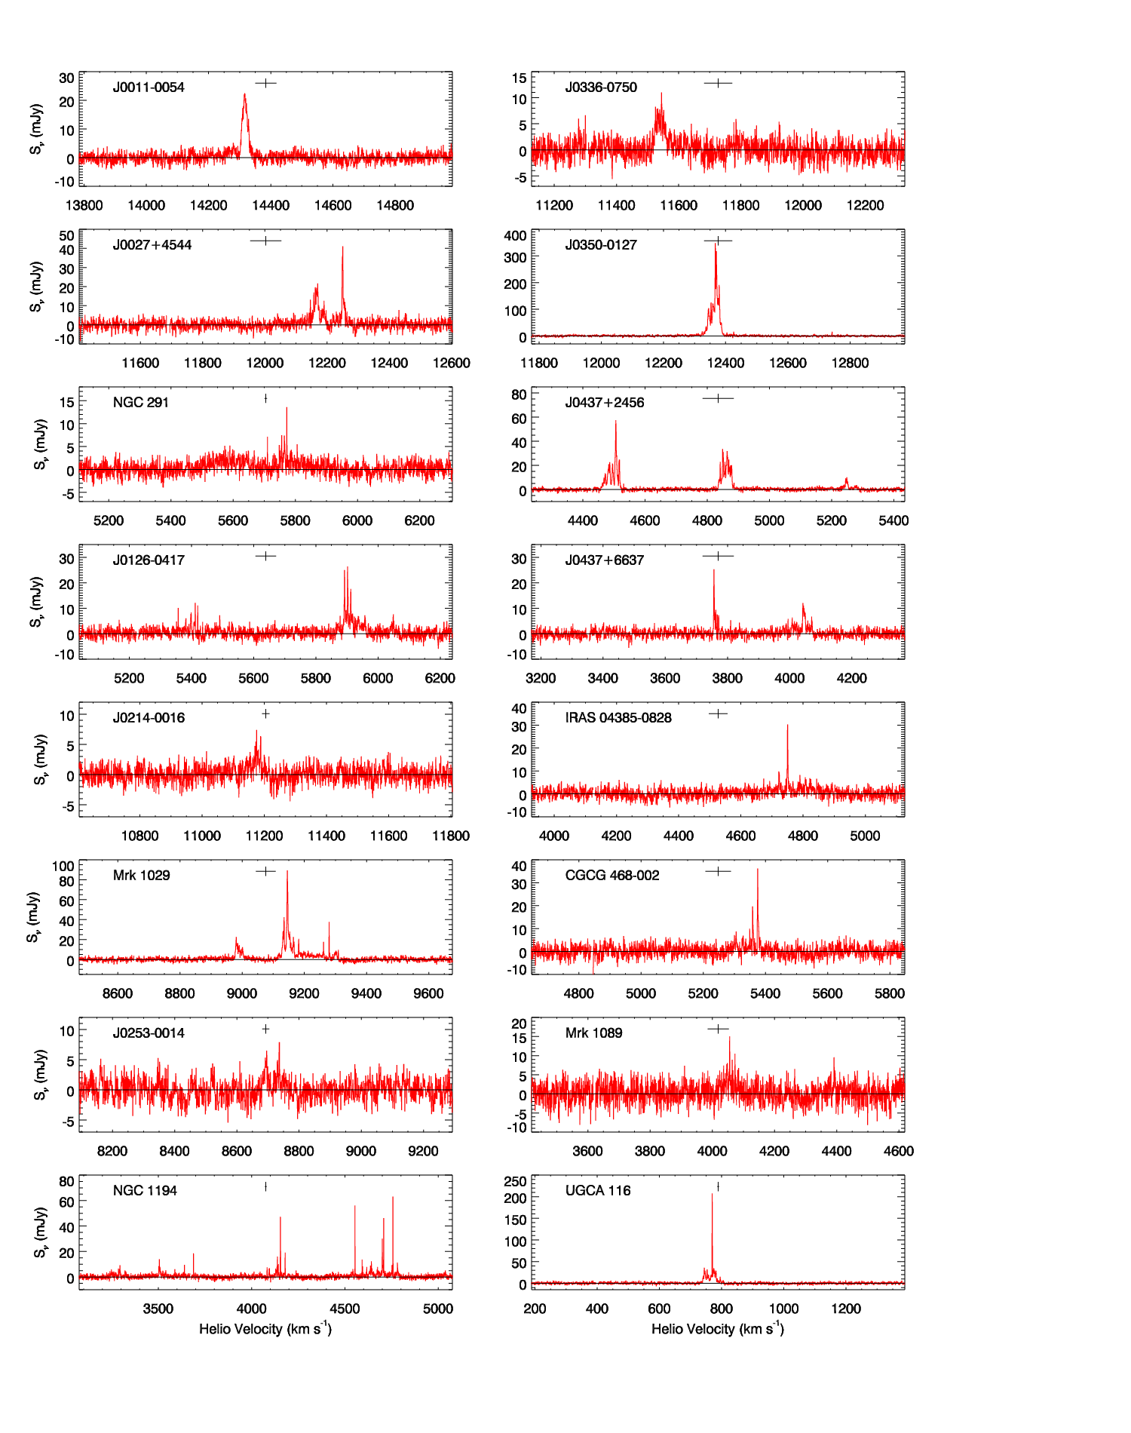
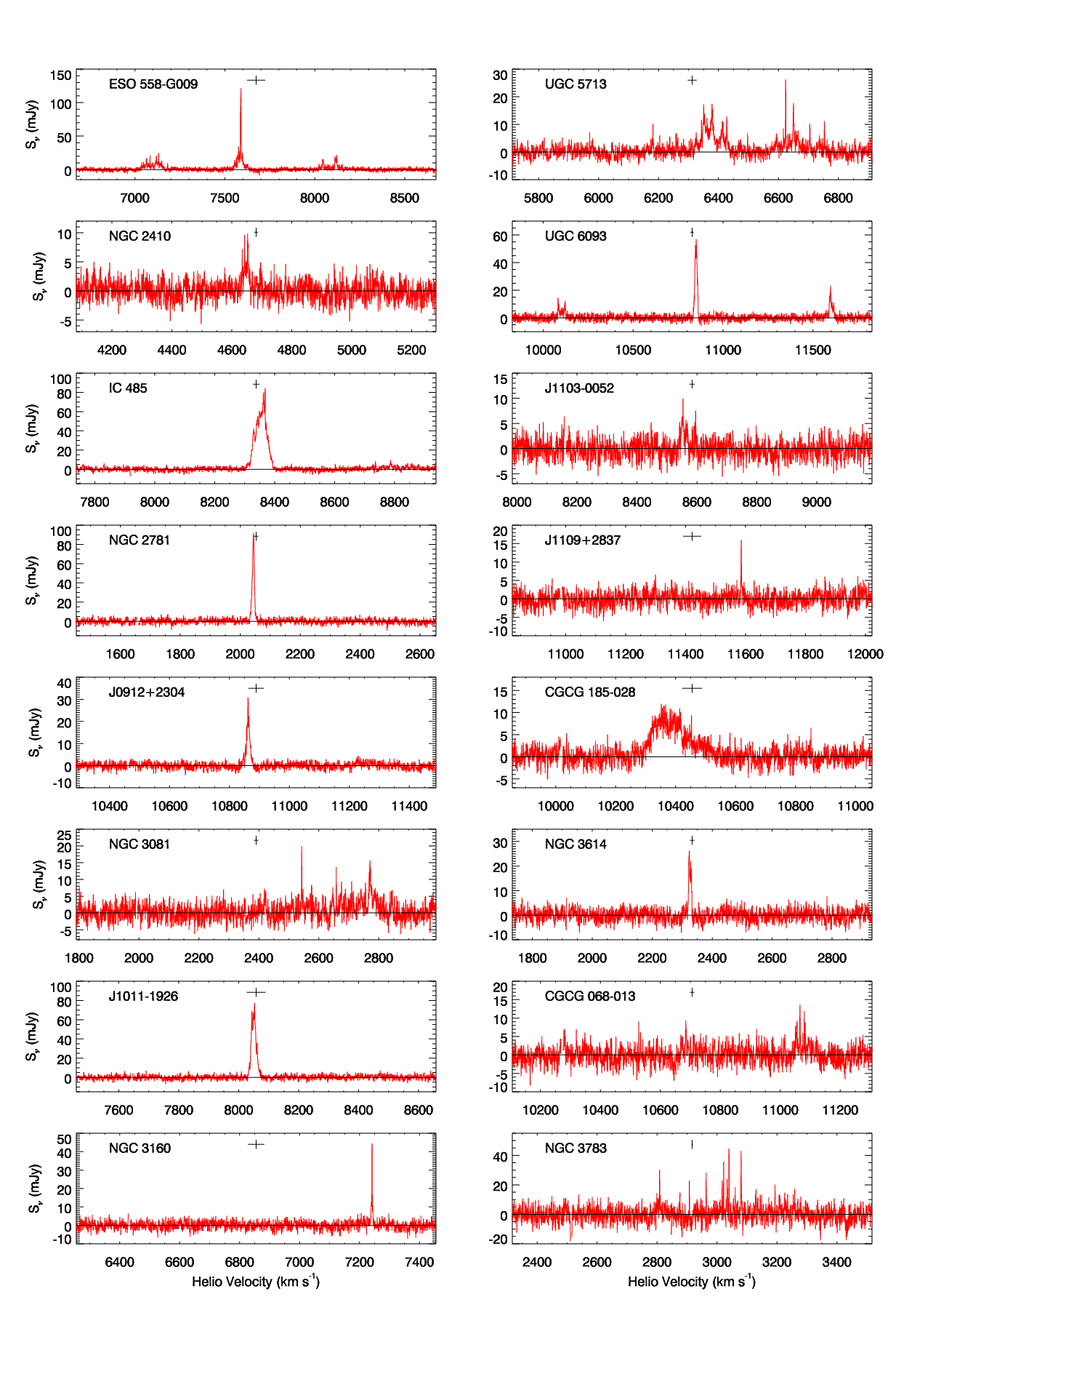

Slide 7
Probing the Extragalactic Distance Scale
ESO 558-G009
Largest Structures
NGC 4258
UGC 3789
J0437+2456
NGC 2273
NGC 1194
Mrk 1419
NGC 6323
NGC 6264
IC 2560
Cepheids
Direct Measurement of H₀
0 Mpc
50 Mpc
100 Mpc
150 Mpc
One method covers all scales out to the size of largest structures

Slide 8
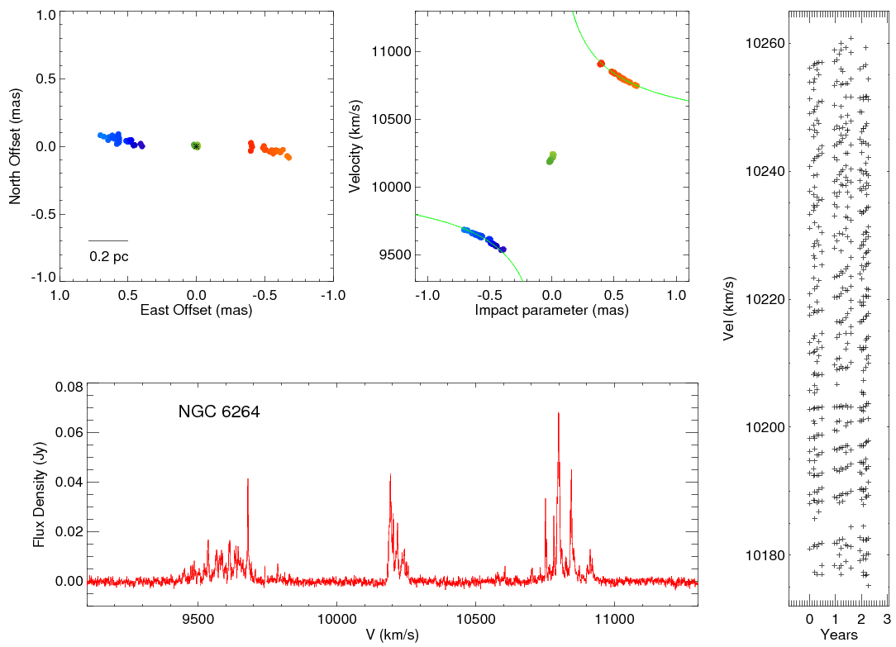
NGC 6264
Discovery: Kondratko et al. 2006
Map: Kuo et al. 2011

Slide 9
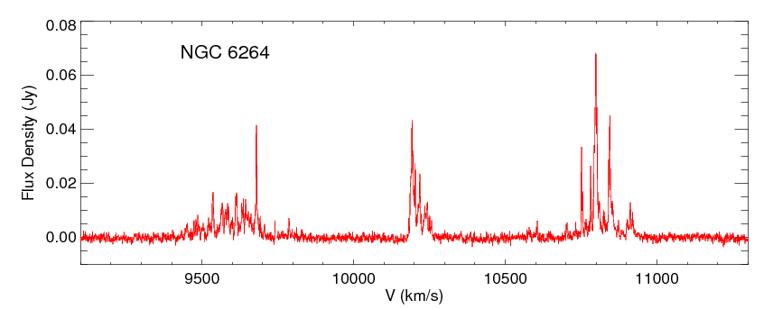
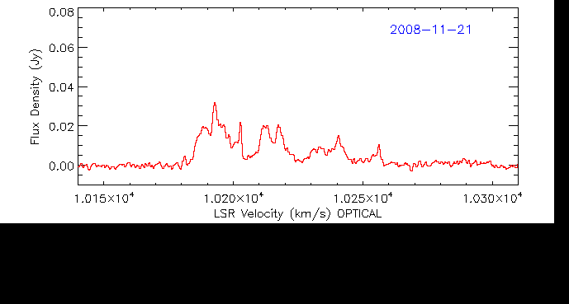
NGC 6264: Systemic Features

Slide 10
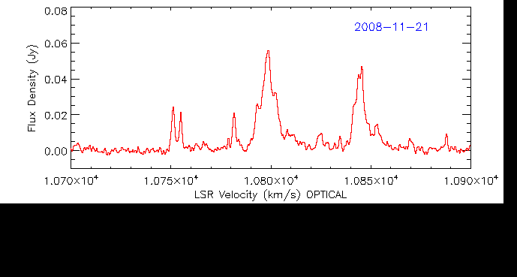
NGC 6264: Red Features

Slide 11
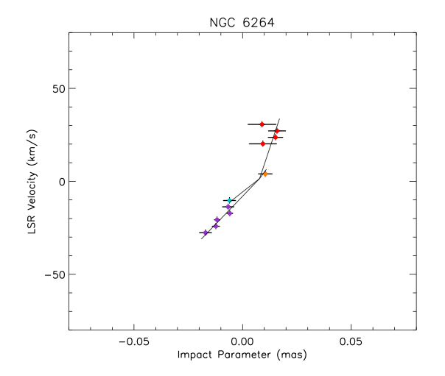
NGC 6264: Fitting the PV Diagram
D = 151 ± 34 Mpc (22%)
(Kuo 2011)

Slide 12
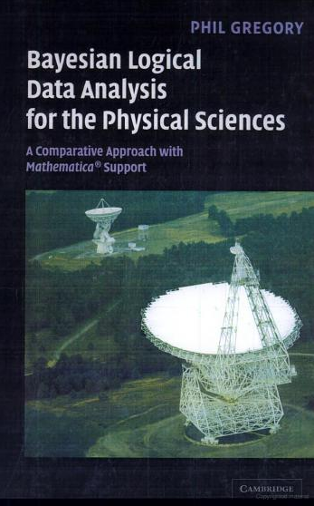
Bayesian Fitting of the Maser Disk
A “brute force” method using a Markov chain Monte Carlo approach
We use the Metropolis-Hastings algorithm to choose successive trial parameters
We model the disk with a warp in two dimensions (position angle and inclination angle)
Inputs: (x, y, v, a) for each maser spot
Code developed by Mark Reid (CfA)

Slide 13
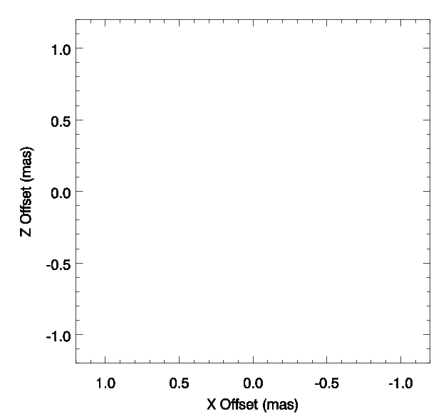

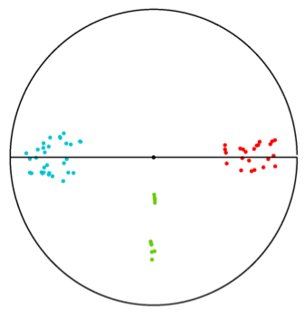
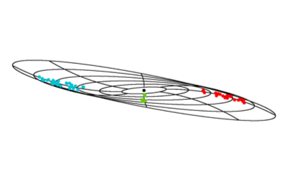
NGC 6264: Bayesian fitting

Slide 14
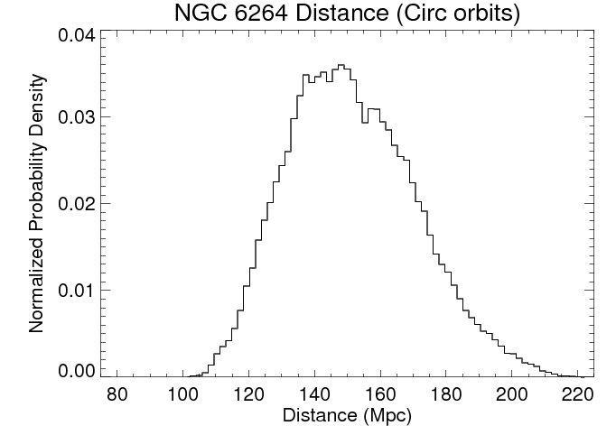
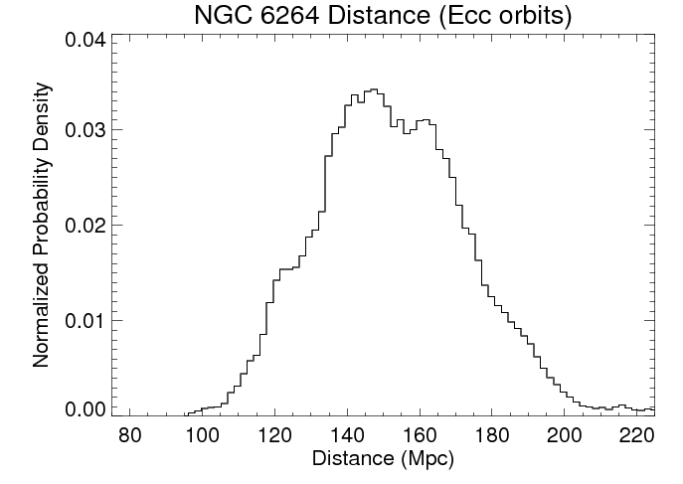
NGC 6264: Distance
PV diagram: 151 ± 34 Mpc (22%)
Circular orbits: 152 ± 20 Mpc (13%)
Eccentric: 153 ± 21 Mpc (14%)
H₀ = 70 ± 10 km s⁻¹ Mpc⁻¹
(Virgo + GA + Shapley flow model)

Slide 15
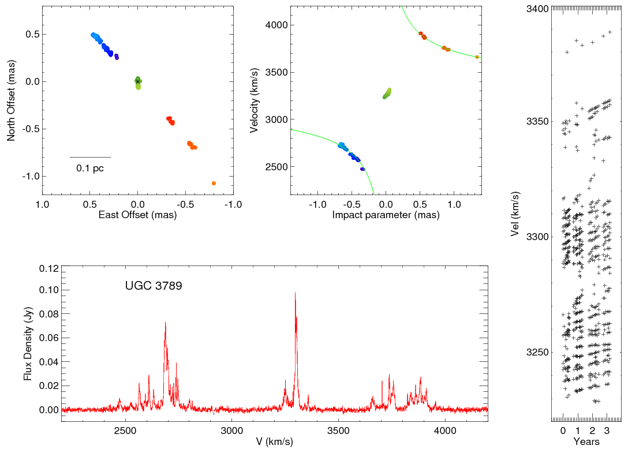
UGC 3789

Slide 16
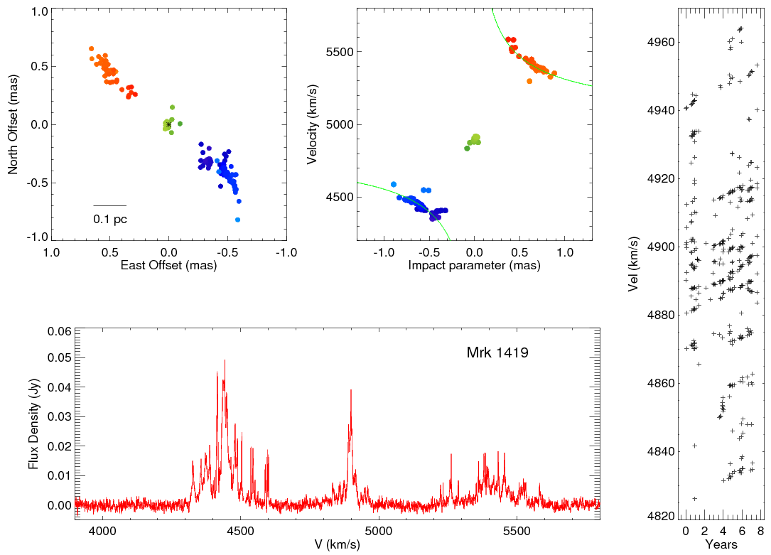
Mrk 1419

Slide 17
Our Best Estimation of H₀
H₀ = 69.4 ± 4.6 km s⁻¹ Mpc⁻¹ (6.6%)
UGC 3789 [50.1 ± 4.0 Mpc] H₀ = 70.5 ± 6.1 km s⁻¹ Mpc⁻¹
NGC 6264 152 ± 20 Mpc H₀ = 70 ± 10 km s⁻¹ Mpc⁻¹
Mrk 1419 81 ± 10 Mpc H₀ = 66 ± 10 km s⁻¹ Mpc⁻¹
[ NGC 6323 121 ± 24 Mpc H₀ = 68 ± 14 km s⁻¹ Mpc⁻¹]

Slide 18
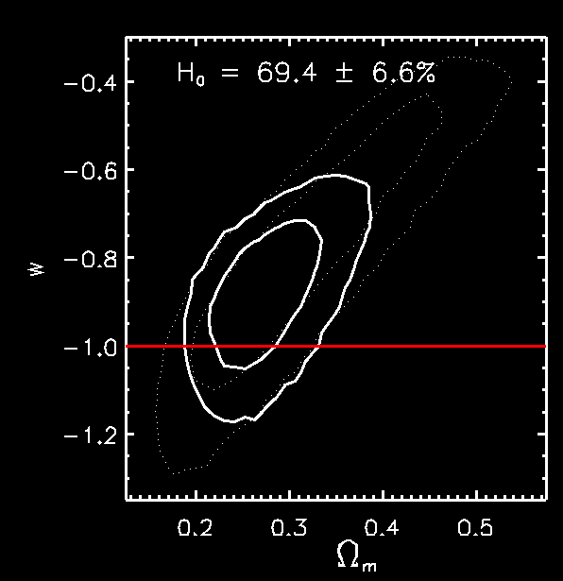
Constraining Cosmological Parameters with
WMAP and H₀
H₀ = 69.4 ± 4.6 km s⁻¹ Mpc⁻¹

Slide 19
Gold Standard SMBH Masses
BH masses from MCP
Earlier maser BH masses
e.g. Kuo et al. (2011)
e.g. Miyoshi et al. (1995); Greenhill et al.
Galaxy | M_{BH} (M_{sun})
Mrk 1419 | 6.5 x 10⁶
NGC 1194 | 6.6 x 10⁷
NGC 2273 | 7.6 x 10⁶
NGC 6264 | 2.5 x 10⁷
NGC 6323 | 1.0 x 10⁷
UGC 3789 | 1.1 x 10⁷
NGC 4388 | 1.5 x 10⁷
NGC 5728 | 2.3 x 10⁶
ESO 558-G009 | 1.8 x 10⁷
J0437+2456 | 1.9 x 10⁶
Mrk 1 | 1.0 x 10⁶
Mrk 1210 | 1.3 x 10⁷
Galaxy | M_{BH} (M_{sun})
NGC 4258 | 3.8 x 10⁷
NGC 1068 | 8.6 x 10⁶
Circinus | 1.7 x 10⁶
NGC 3393 | 3.1 x 10⁷
NGC 3079 | 2.0 x 10⁶
IC 2560 | 2.0 x 10⁶

Slide 20
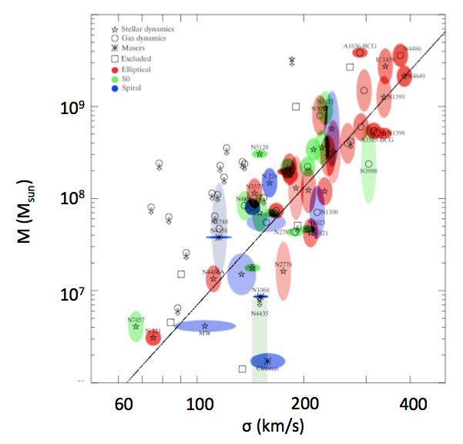
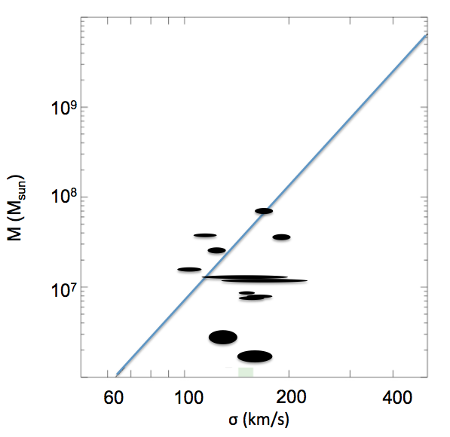
Gold Standard Masses of SMBHs with H₂O Megamasers
M-σ Relation
M-σ Relation (Maser masses only)
Gultekin et al. 2009
Greene et al. 2010; Kuo et al. 2011

Slide 21
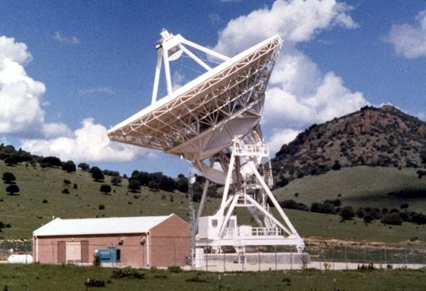
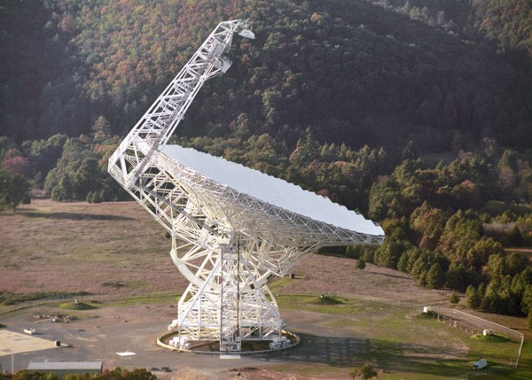
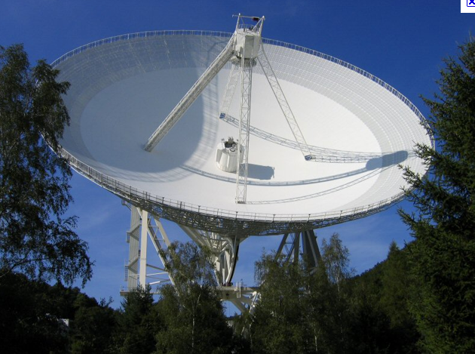
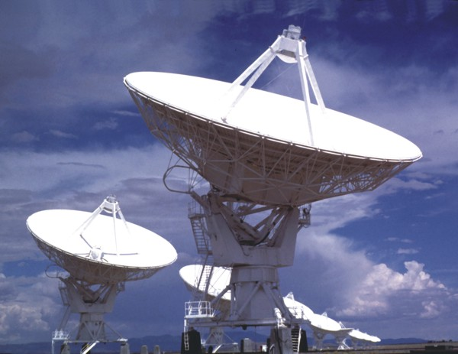
Looking to the future
Sensitivity is the key
Jansky VLA will be added as a phased array; ~ 30% improvement in noise compared to current obs.
Other telescopes? LMT; DSN; SRT
High-frequency SKA (2025?)

Slide 22
Extra Slides

Slide 23
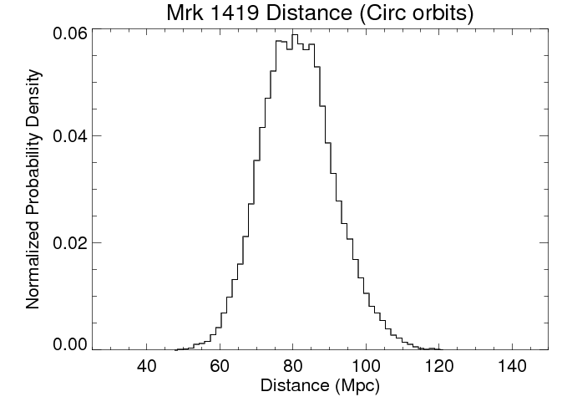
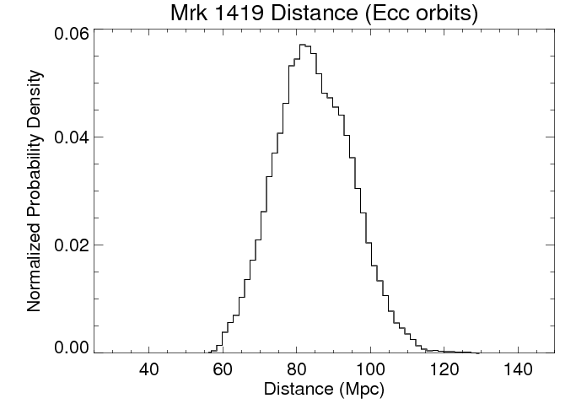
Mrk 1419: Distance
Circular orbits: 81 ± 10 Mpc (12%)
Eccentric: 84 ± 11 Mpc (13%)
H₀ = 66 ± 10 km s⁻¹ Mpc⁻¹

Slide 24
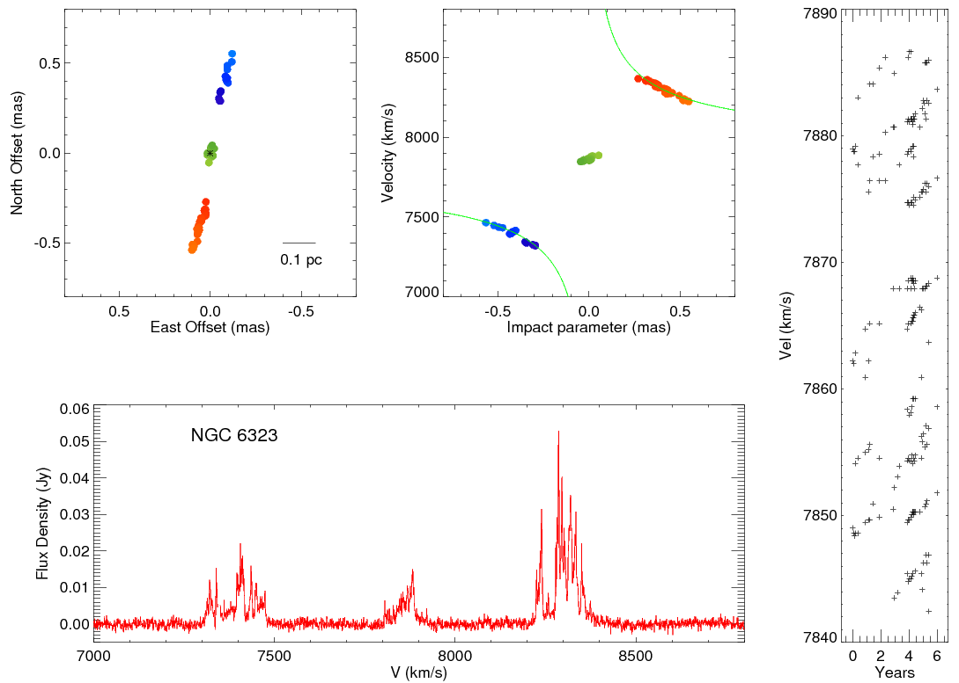
NGC 6323

Slide 25
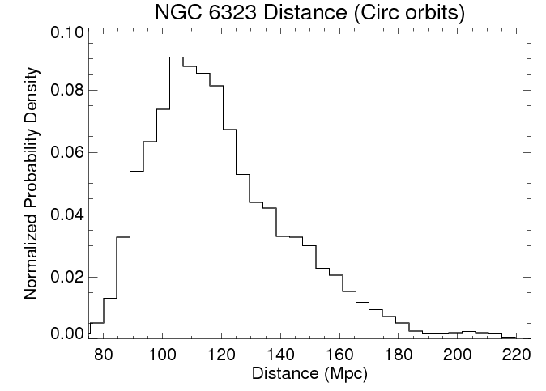
NGC 6323: Distance
Circular orbits: 121 ± 24 Mpc (20%)
H₀ = 68 ± 14 km s⁻¹ Mpc⁻¹

Slide 26


The Challenge of Imaging Distant Disks
NGC 4258
beam
NGC 6323

Slide 27
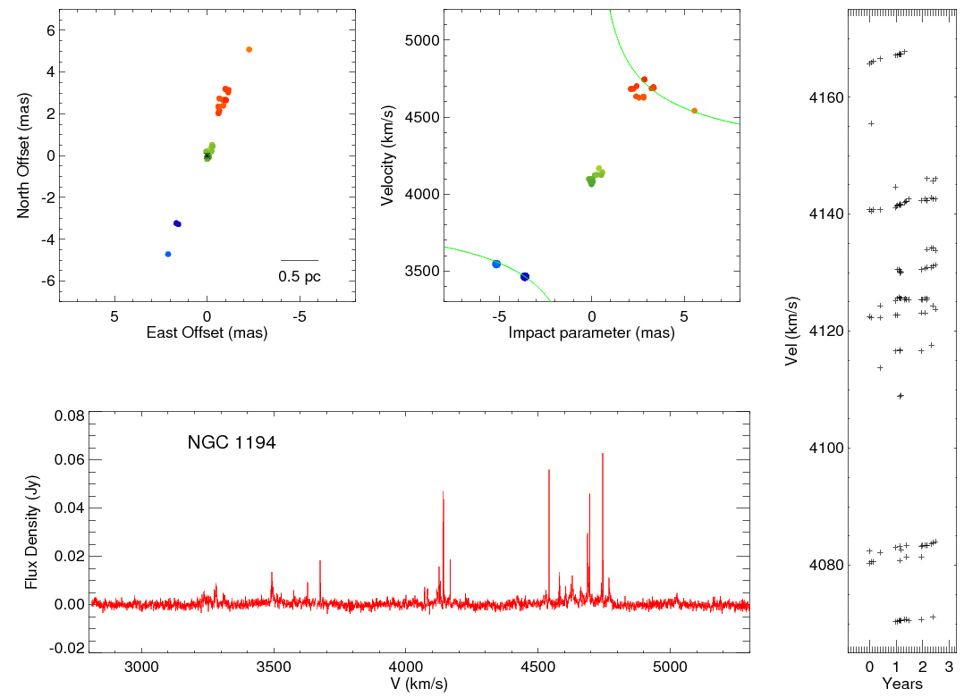
NGC 1194

Slide 28
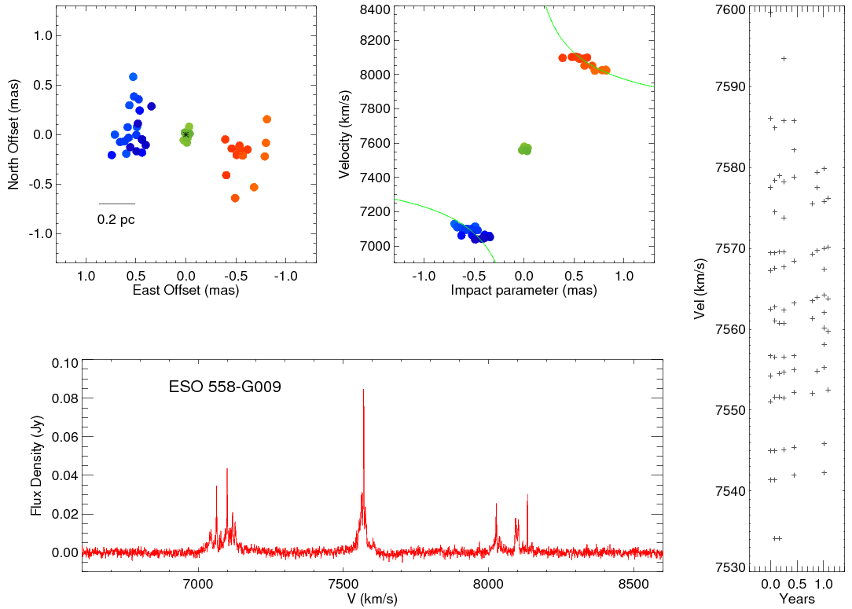
ESO 558-G009

Slide 29
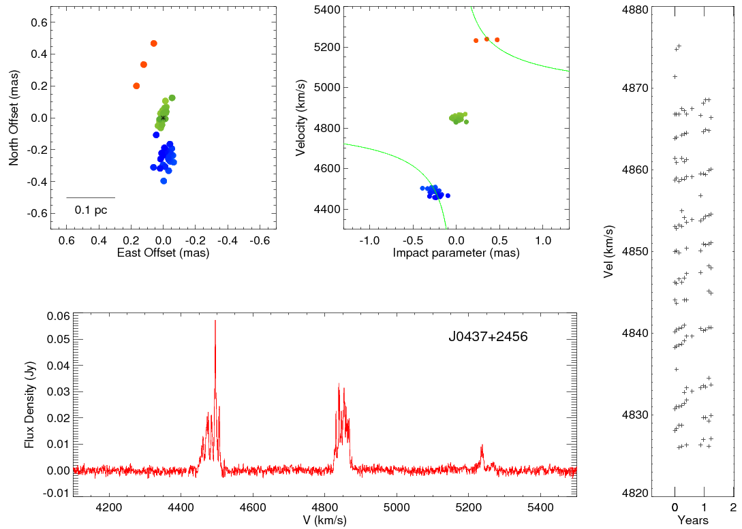
J0437+2456

Slide 30
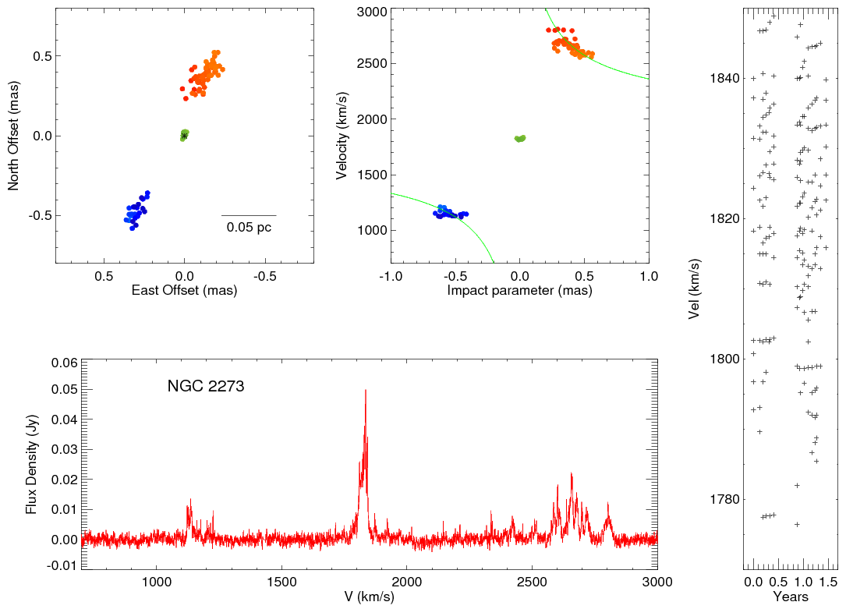
NGC 2273

Slide 31
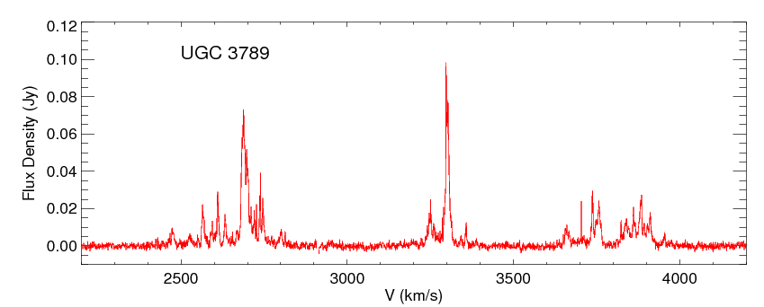
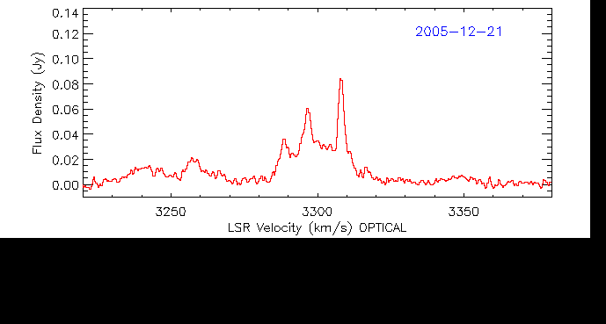
UGC 3789: Systemic Features

Slide 32
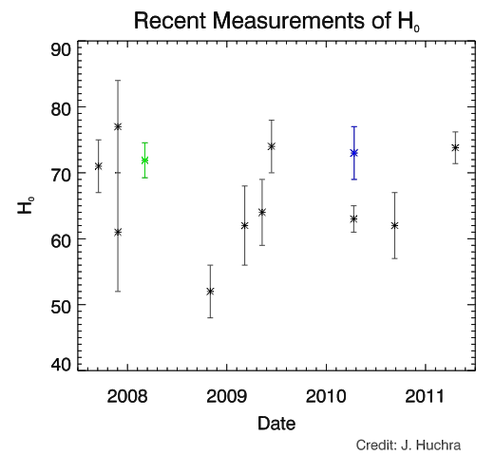
The State of H₀
Riess et al.
Courbin et al. (grav lensing)
Sandage et al.

Slide 33
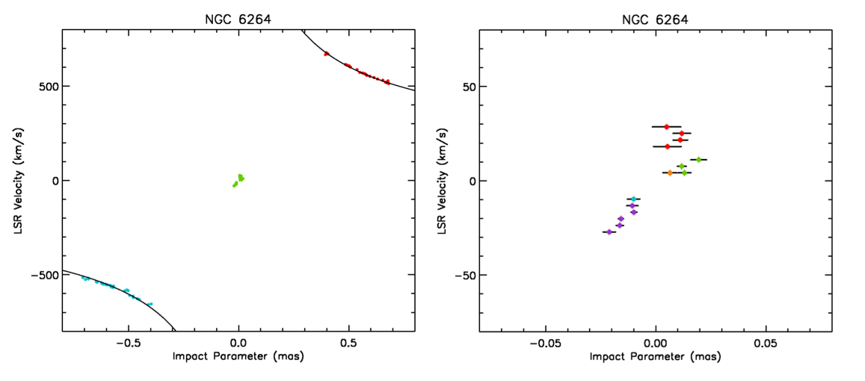
NGC 6264: A Closer Look at the PV Diagram
Accelerations: 1.07 km s⁻¹ yr⁻¹ 1.79 km s⁻¹ yr⁻¹
0.74 km s⁻¹ yr⁻¹ 4.43 km s⁻¹ yr⁻¹
1.55 km s⁻¹ yr⁻¹

Slide 34

Looking to the (farther) future
To consider achieving ~ 1% H₀ with masers, we need the High-Frequency SKA (2025?)
A system 10 - 80 times more sensitive than the GBT would detect ~ 30 – 700 times more masers
Need a core of antennas in a good weather site with substantial collecting area in outrigger antennas for (inter)-continental baselines
Sensitivity limits our reach for new galaxies, and also limits the uncertainty in our current sample

Slide 35
The Megamaser technique
Strengths
  The technique gives a geometric measurement of H₀ independent of the cosmological model
  One method can be applied to all galaxies out to ~ 200 Mpc – no “ladder”
  Conceptually simple
  Independent of all other techniques
Weaknesses
  Precision currently lags the state of the art; expect 5-6% in a few years
  Very few galaxies are eligible for the technique
  Requires significant observing resources and ~ 2 years of observations per galaxy (can do more than one at a time)
Needs
  Sensitivity

Slide 36
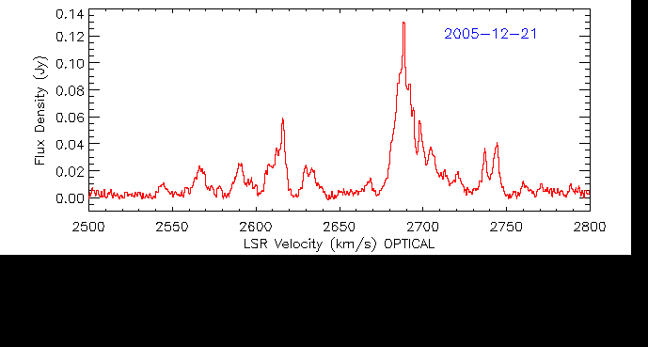
UGC 3789: Blue Features

